Slide 1
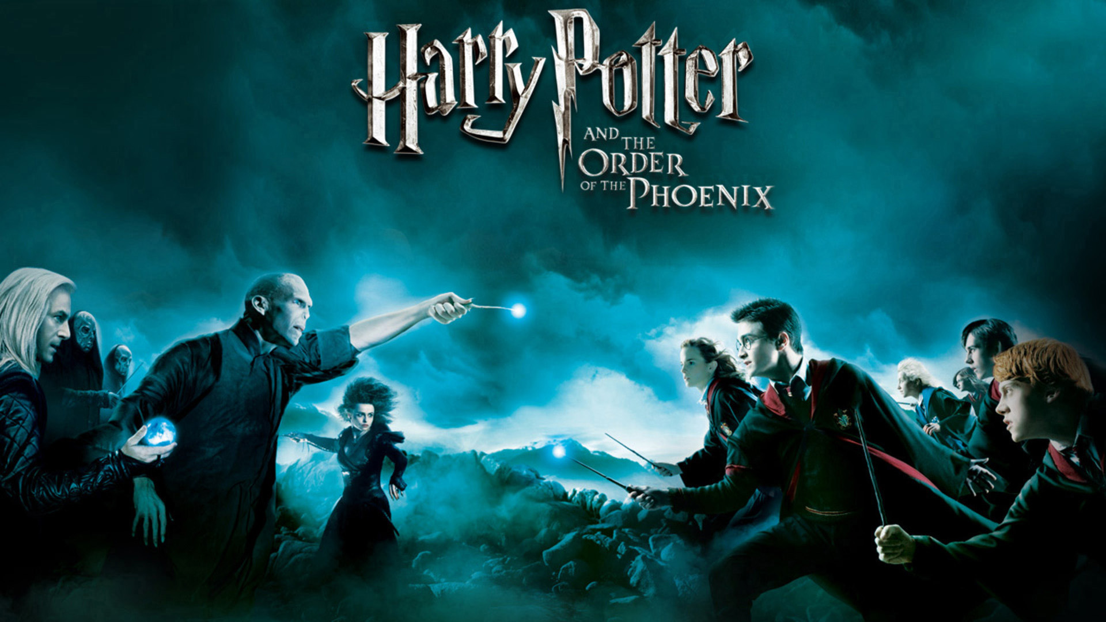
*Kids Quest*
Harry Potter Adventure
Click “Present” in the top right to begin, then click here!

Slide 2
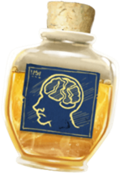
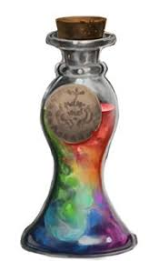
Try to survive your day as a novice wizard! Make good choices! Press the button below to begin your adventure.
Choose an item below to help you through your
journey. Don’t forget to use it when you can!
Fire Protection Potion - defeat a fire-based creature!
Memory Potion -
Boost your brain!
Girding Potion - give yourself more stamina!
Play Game

Slide 3
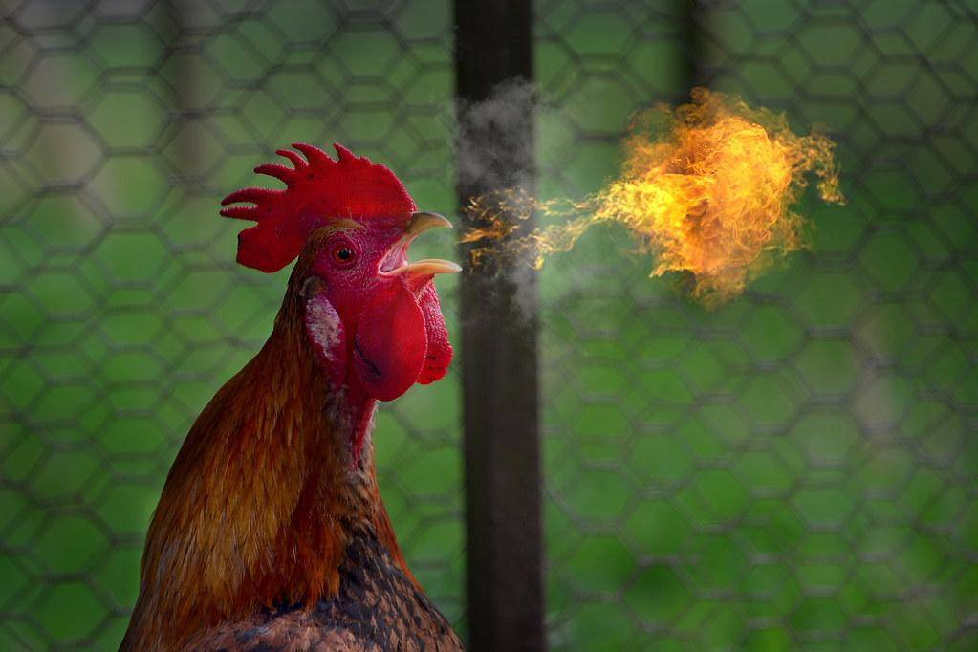
You are walking alone down the hall at
hogwarts and hear a loud shriek from around the corner, then see a fire-breathing chicken running towards you!!!
On the next pages, choose an action (exercise) to combat the creature. do it until the timer hits zero. then click on the button matching your choice to see what happens:
Continue
Notes:
A1

Slide 4
Continue
Notes:
A1

Slide 5
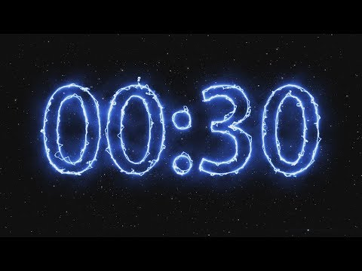
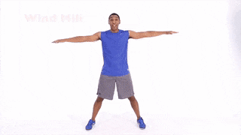
The chicken attacks! What do you do?
Run
Away!
Use your
Fire potion
OR
Wand: Disappearus
OR
Notes:
A1

Slide 6
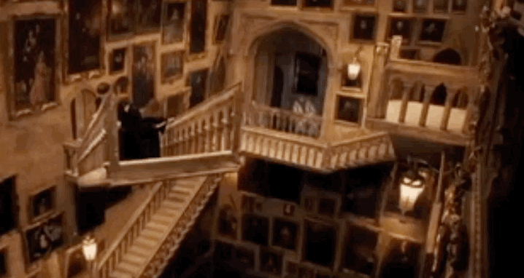
You wave your wand. “Disappearus!” The chicken goes *Poof* and is no longer a threat!
That was most unexpected. Where do you want to go now? Up or down the next staircase?
Go Up!
Go Down!
Notes:
A1

Slide 7
*Cuh Chug Chug* You drink the potion and the fire breath doesn’t hurt you at all! The chicken gives up and runs away down the hall.
You have to decide where to go next. Up or down the next the staircase?
Go Up!
Go Down!
Notes:
A1

Slide 8
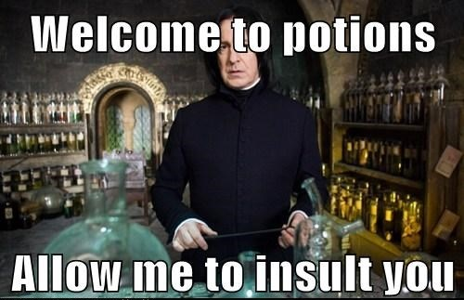
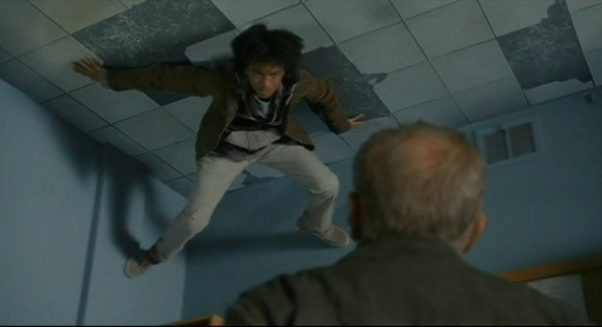
You end up at the potions classroom, and professor Snape invites you in to show his class how to deal with a threat. He throws a potion on the floor at your feet! You float upwards and get stuck to the ceiling!
Your mind races and you can hear the class *gasp* in shock. What do you choose to do?
Next
Notes:
A1

Slide 9
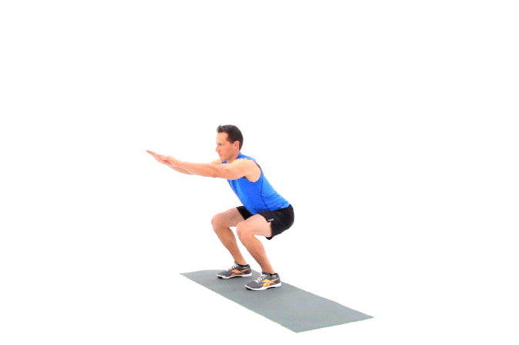
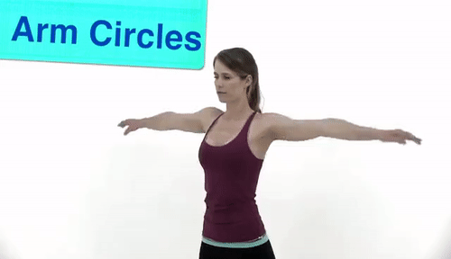
You’re stuck to the ceiling! How do you get down?
Wand: Lowerus selfus
Brain
potion
Wand: selfus
Stone formus!
OR
OR
Notes:
A1

Slide 10
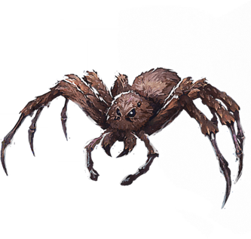
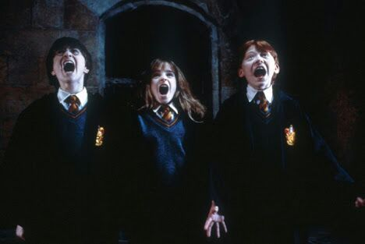
You recall the ability to lower yourself, and by beating Snape’s test, he begrudgingly gives you a backhanded compliment.
You hear a call for “Help!” from Hermione. You race off towards her! When
you get to the magical creatures classroom, you see a rather large acromantula!
Continue
Notes:
A1

Slide 11
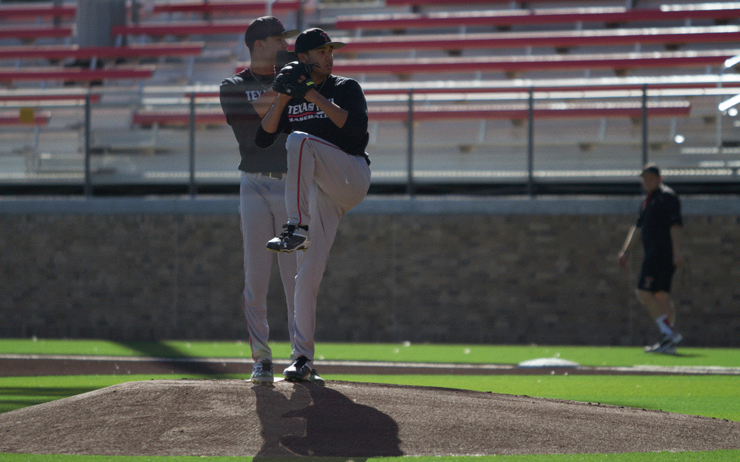
The acromantula is about to attack. What do you do?
Throw a sword at it!
Girding
potion
Wand: disappearus!
OR
OR
Notes:
A1

Slide 12
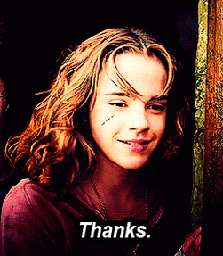
You point your wand and say “Disappearus!” and nothing happens. Ron shrieks as it gets closer! Hermione says to focus! You try again and the Spider goes *poof*! You saved the class!
No time to rest, you hear a strange voice calling for you to follow it. You feel like you should listen...
Continue
Notes:
A1

Slide 13
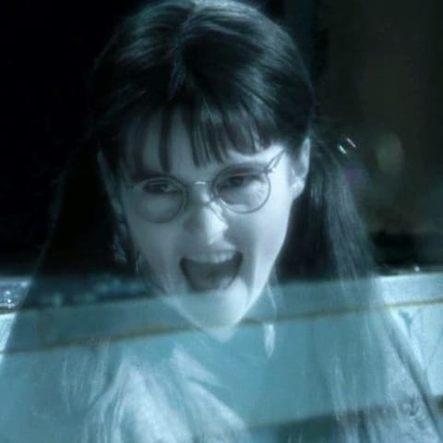
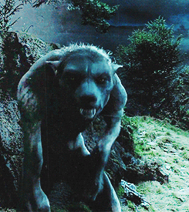
You follow the voice and find out that it’s Moaning Myrtle down a side hallway. She says Hagrid’s in trouble and needs your help by his house! You rush there as fast as you can, and find him being attacked by a werewolf! “Help me Harry!”
Continue
Notes:
A1

Slide 14
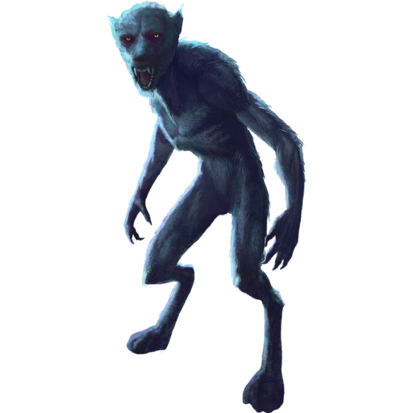
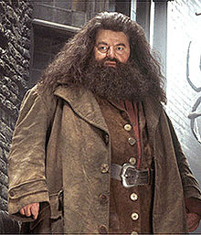
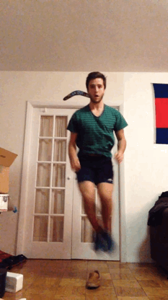
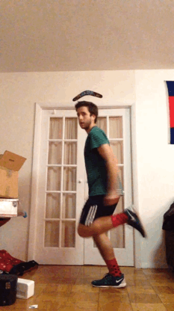
How can you stop
the werewolf!?
Use Wolfsbane!
Wand: Disappearus!
OR
Notes:
A1

Slide 15
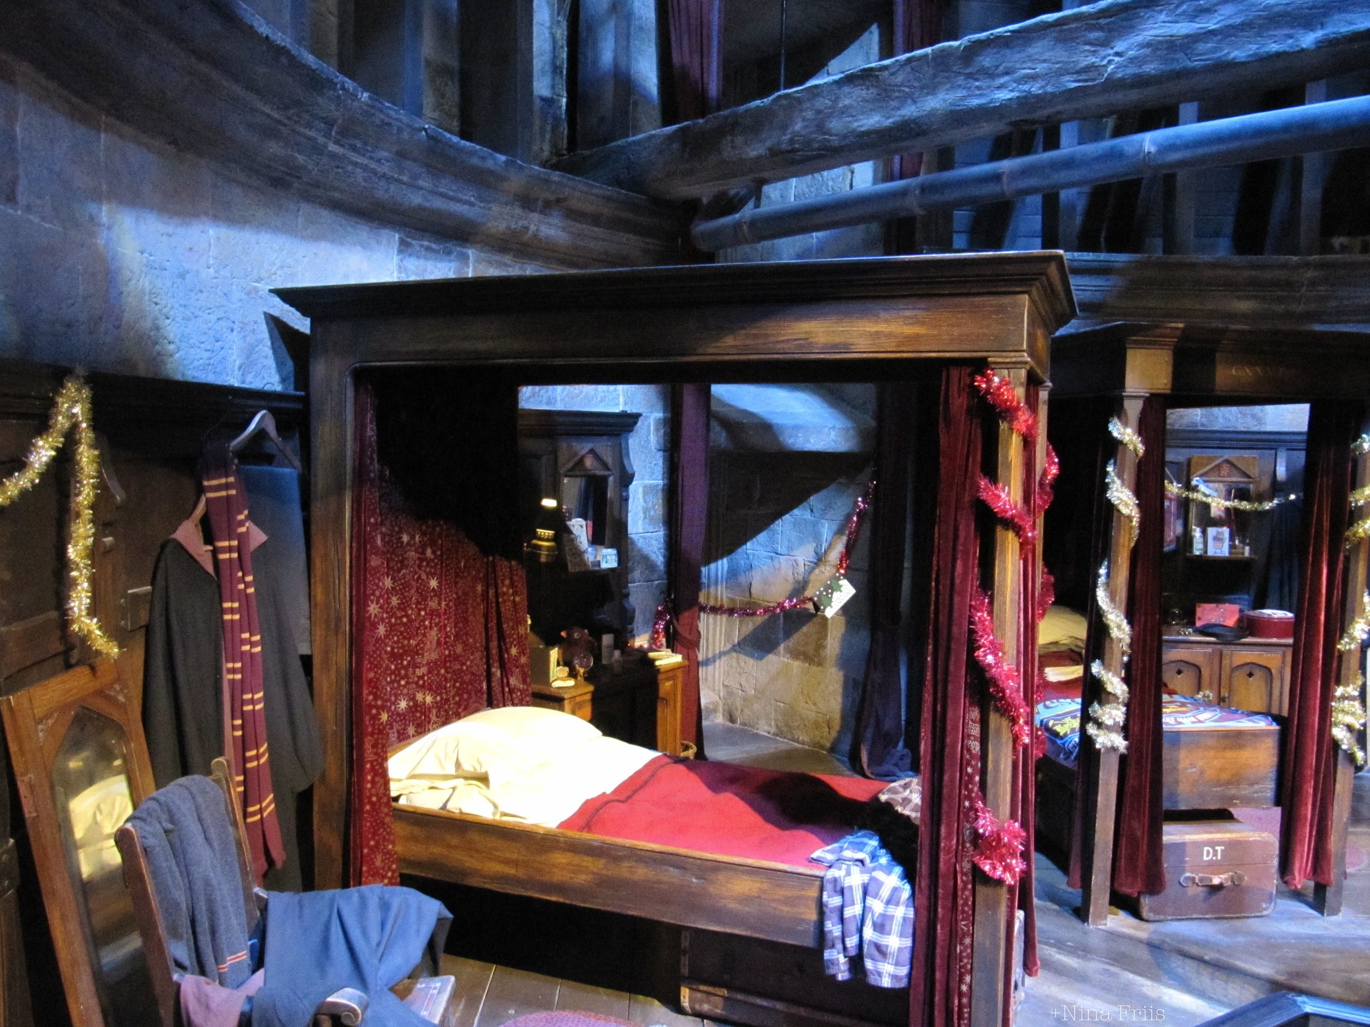
The werewolf regains its human thoughts, and apologizes for what she did! She runs off ashamed. Hagrid thanks you!
Where do you want to go next?
Thanks Harry!
Your room
To the
Library
OR
Notes:
A1

Slide 16
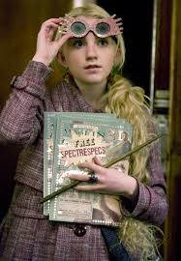
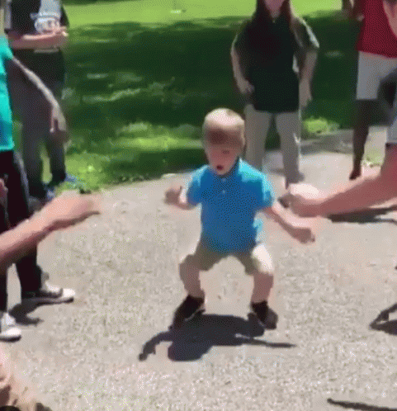
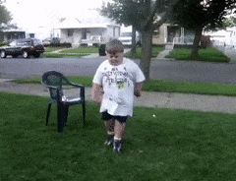
You run into Luna, and she asks you to dance with her
as an experiment! Pick:
Spazz!
OR
Cross
feet!
Notes:
A1

Slide 17
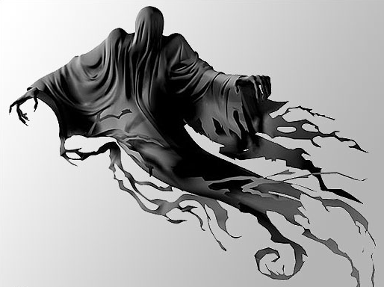
After a bit of embarrassment, Luna seems happy with the results. She writes in her journal and walks away...
You feel good about helping her, then all of the sudden, a Dementor appears out of nowhere! It’s about to attack a student!
Continue
Notes:
A1

Slide 18
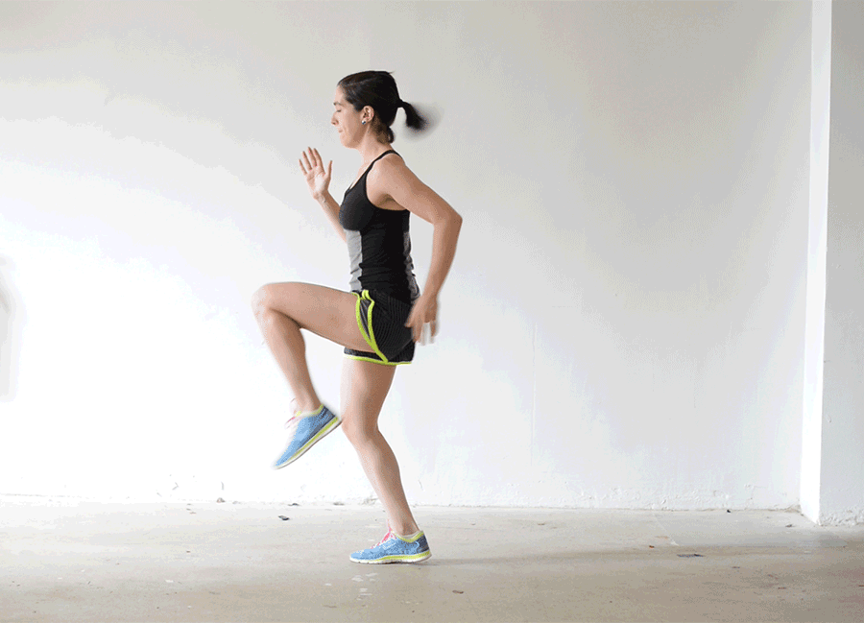
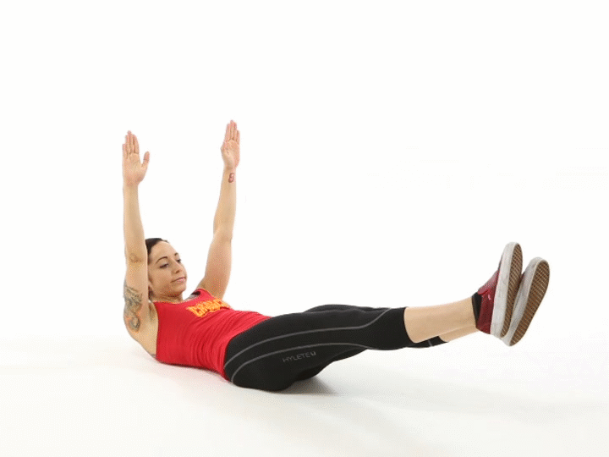
How do you proceed?
Tell everyone to run!
Wand: Patronus
Charm
OR
Notes:
A1

Slide 19
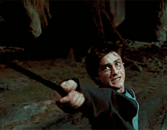
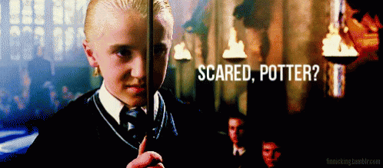
You did it! One of the hardest spells to cast! The dementor is blown away! You look very tired...
All of the sudden Malfoy uses this opportunity to attack you. After all you did to save everyone!? Get ready to battle!
Continue
Notes:
A1

Slide 20
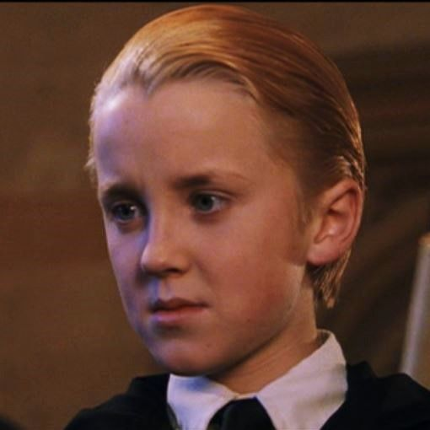
What wand spell do you choose to use?
Lightning!
OR
Fire!
Notes:
A1

Slide 21
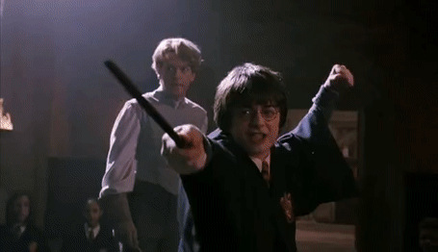
Defeating the Dementor took a lot out of you, but you still have enough energy to defeat the annoying Malfoy! You knock him out and he’s taken to the nurse!
Continue
Notes:
A1

Slide 22
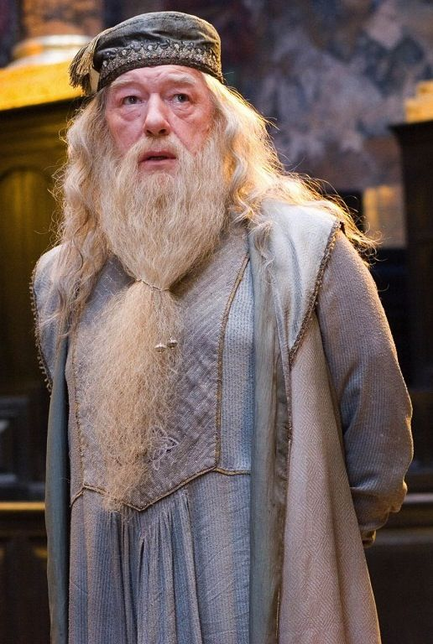
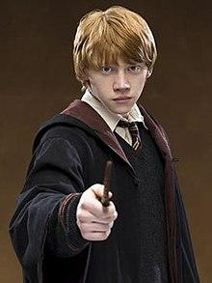
With all the danger gone, you now have to decide where to go next. Do you visit Ron or Dumbledore?
Dumbledore
OR
Ron
Notes:
A1

Slide 23
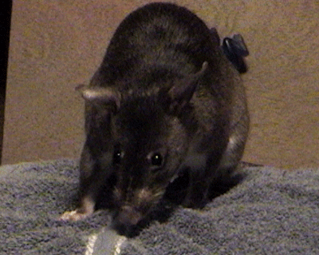
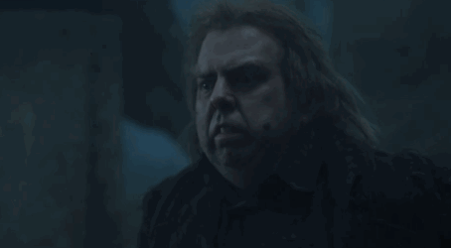
On your way to visit,
a rat squeaks and grows larger in the hallway...to become peter pettigrew! He says “hello potter” and attacks! Is there never a dull moment?
Continue
Notes:
A1

Slide 24
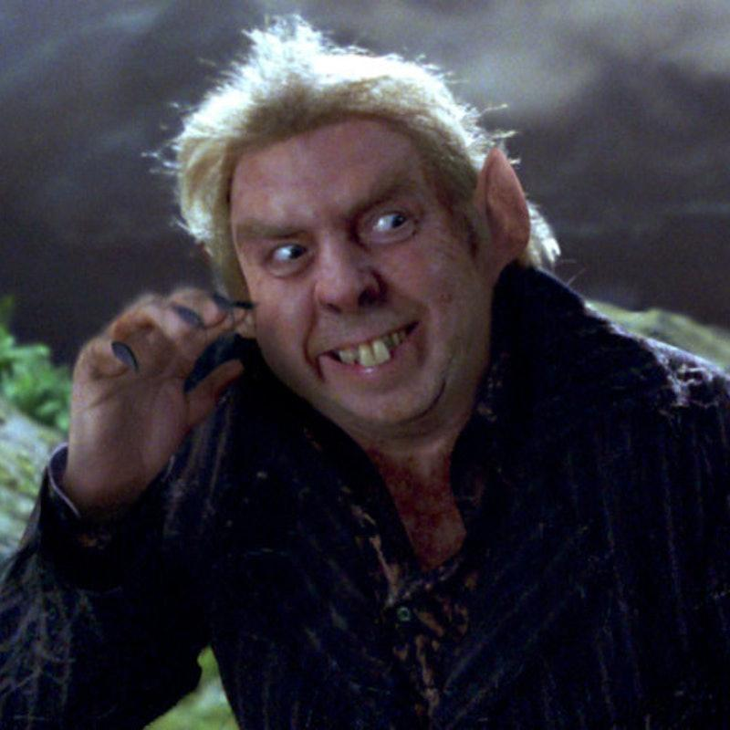
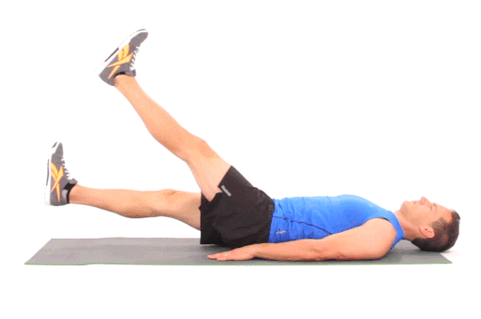
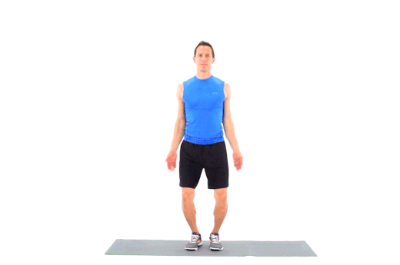
You get one chance
to react with your wand!
Cagus animus!
lightning!
OR
Notes:
A1

Slide 25
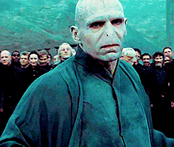
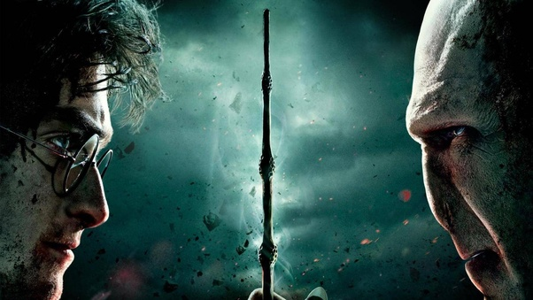
You cast a force cage that stops Peter in his tracks. He shrinks back to a rat and is caught!
Before you can celebrate, a voice makes you tremble, “I’m going to destroy you.” It’s Lord Voldemort himself! What do you do?
Continue
Notes:
A1

Slide 26
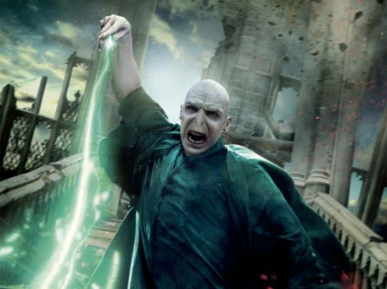
Make your choice!
Block his attack
Start an attack
OR
Notes:
A1

Slide 27
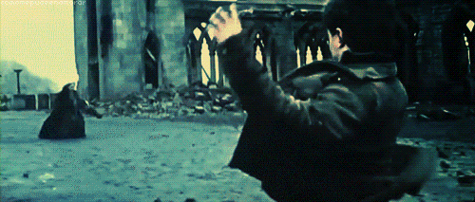
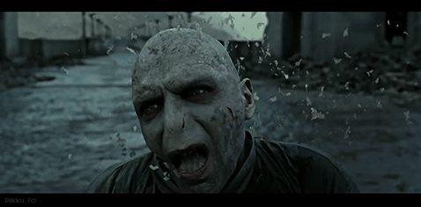
Voldemort didn’t anticipate your speed and power!
Continue

Slide 28
Congratulations! You have defeated
Lord voldemort!
Try my superhero version!

Slide 29
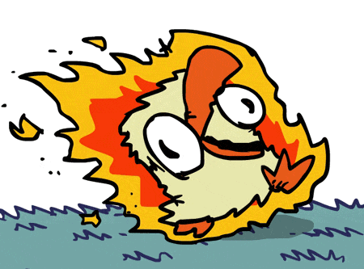
You try to outrun the chicken, but it’s too fast! You’ve been roasted and defeated. Dust yourself off and
try again!
Try again!

Slide 30
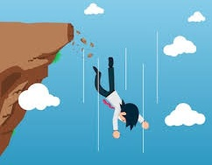
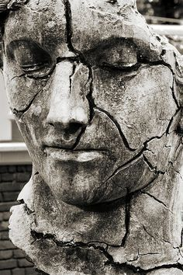
you transform yourself into a heavy statue, and while you do fall down...you crumble into pieces! You have been defeated. Try again!
Try again!

Slide 31
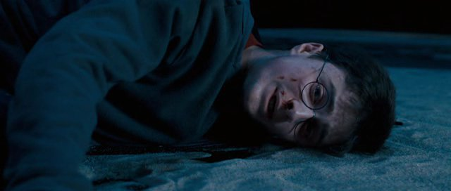
When you throw the sword, it bounces off the spider’s fangs. It pounces on you. You have been defeated. Try again!
Try again!

Slide 32
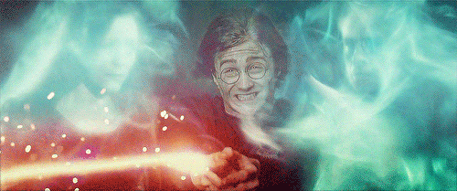
You try to make the werewolf disappear, but it doesn’t seem to work on such a power creature! Before you can act again, it’s too late. You have been defeated. Try again!
Try again!

Slide 33
When you run away, you trip on something and the Dementor gets you.
You have been defeated. Try again!
Try again!

Slide 34
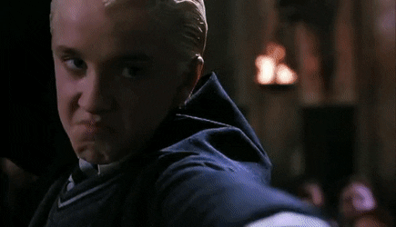
You didn’t know that malfoy had a magical fire protection cloak on. He laughs as his spell knocks you out. You have been defeated. Try again!
Try again!

Slide 35
You decide on lightning, which peter anticipated and blocks with ease. His spell knocks you out. You have been defeated. Try again!
Try again!

Slide 36
You decide to block voldemort’s attack, and it’s just too powerful and drains your energy quickly, leaving nothing to fight back with. You have been defeated. Try again!
I win, it is done!
Try again!

Slide 37
This adventure was created by:
Mike ginicola @physeddepot
Youtube
channel
My website
TPT store
Follow me
On twitter

