Slide 1
*Kids Quest*
Superhero Adventure
By: Mike Ginicola
@PhysedDepot
PhysedDepot.Com
Click “Present” in the top right to begin, and advance the slide!

Slide 2
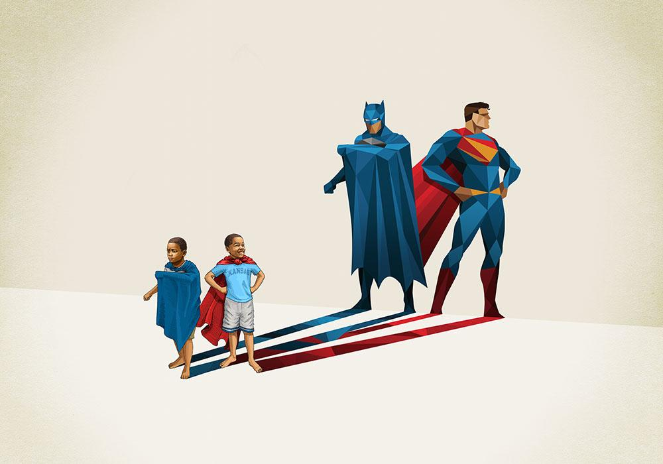
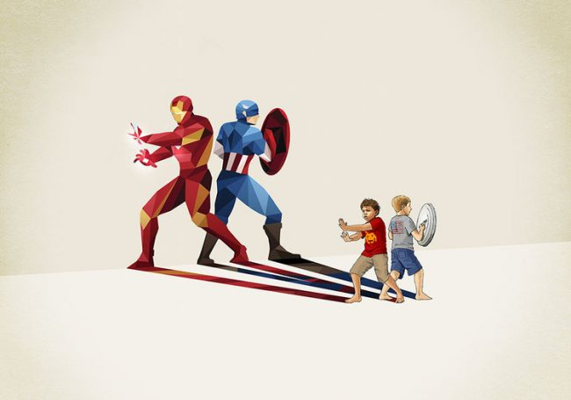
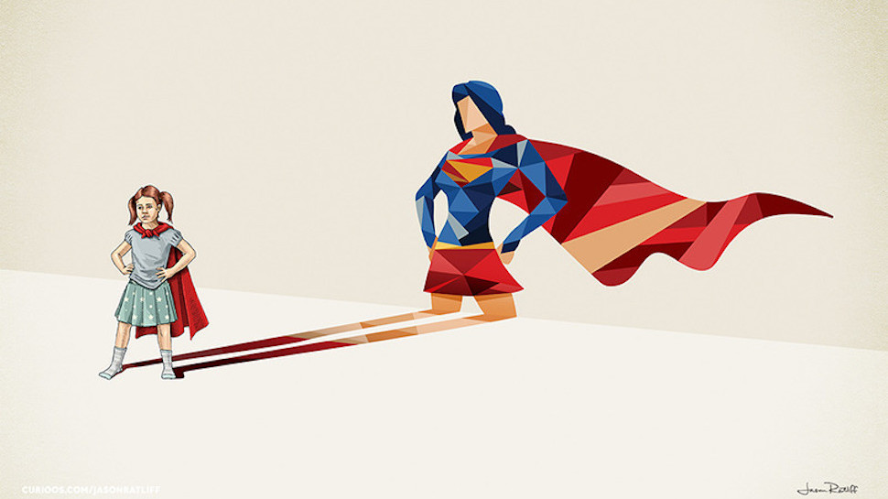
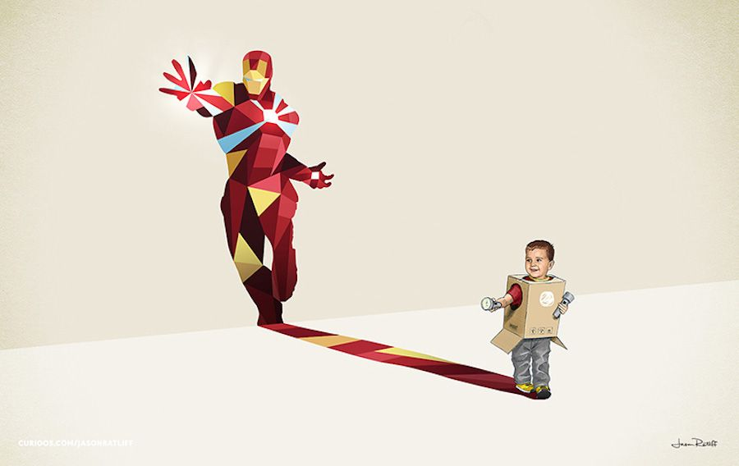
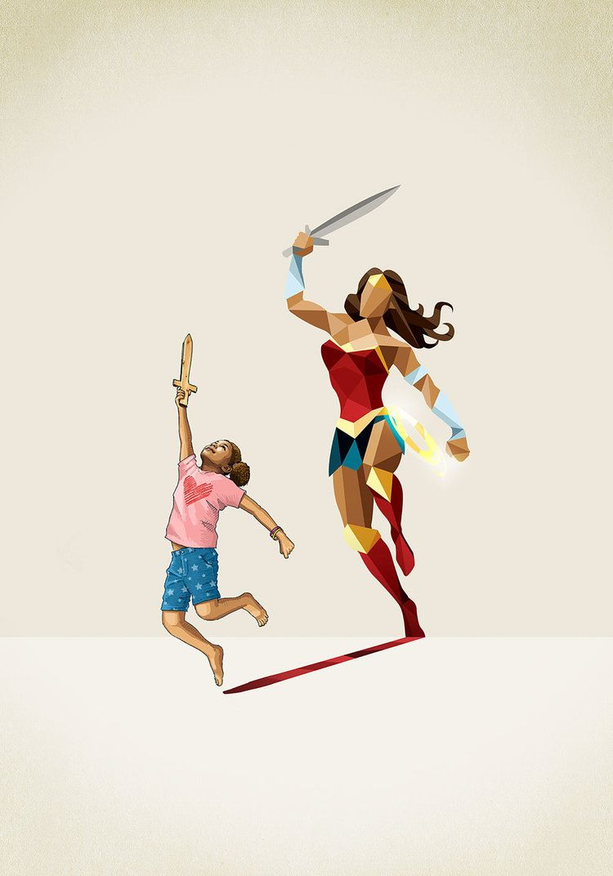
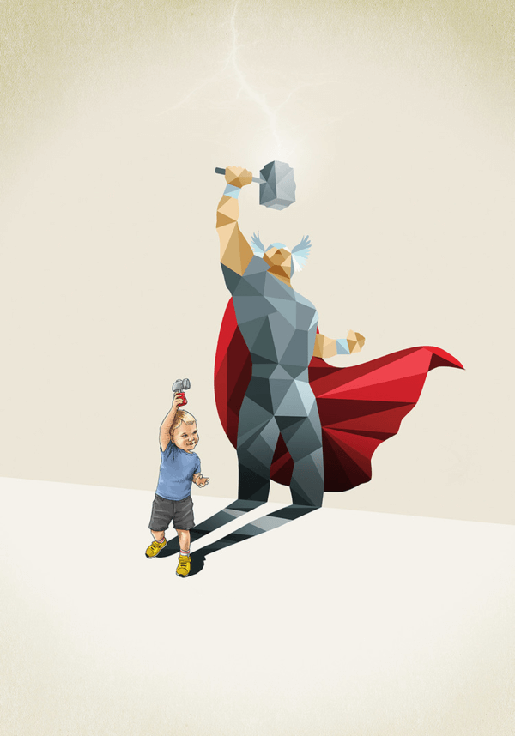
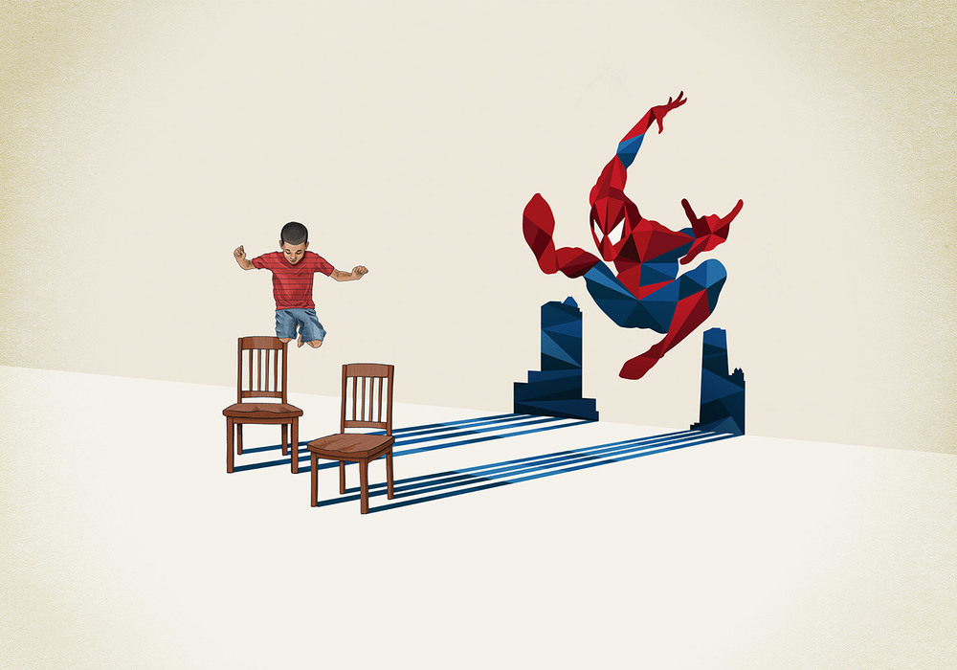
Try to survive your first day as a superhero! Make good choices! Press the button below to begin your adventure.
Play Game

Slide 3
You were walking down the street and got *zapped* by a bright purple ray from the sky. You start to feel powerful. You hear someone scream, and feel like you can help. When
you get there, you see a scary robot trying
to electrocute a little girl and her dog.
On the next page, choose an action (exercise) to combat the robot. do it until the timer hits zero. then click on the button matching your choice to see what happens:
Continue
Notes:
A1

Slide 4
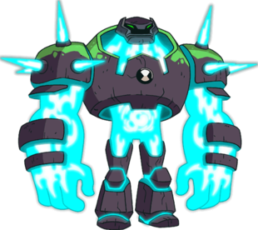
The robot tries to grab you. What do you do?
SuperPunch
Mighty Kick
Notes:
A1

Slide 5
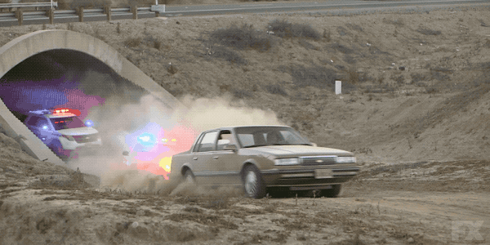
*Ka-Boom!* You broke the robot with a series of mighty kicks. The girl says “thank you.”
No time to rest, you hear police sirens coming towards you! A car races down the street next to a cliff. How can you stop it? Do you try to outrun the car or jump onto it?
Continue
Notes:
A1

Slide 6
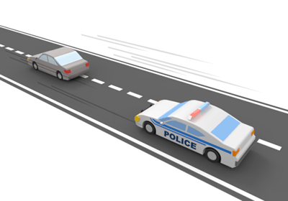
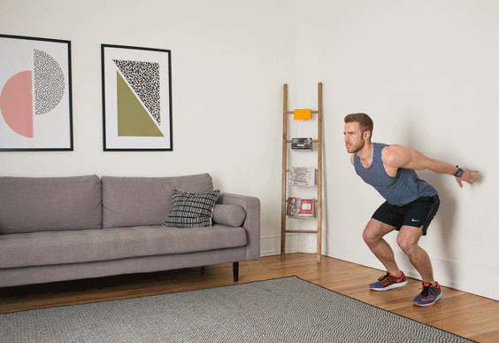
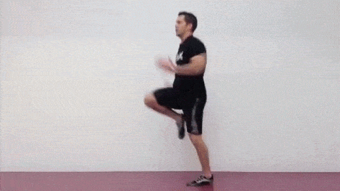
The car is racing by you. What do you do?
Jump!
run!
Notes:
A1

Slide 7
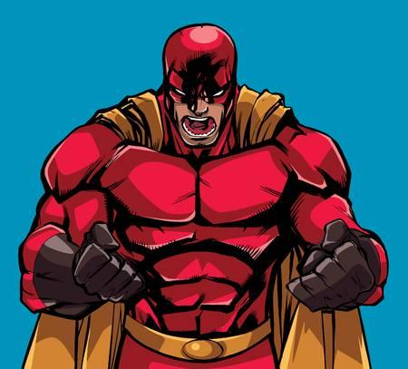
You run at super speed and startle the driver into swerving and crashing, and the police are able to arrest them. “Thanks Kid, can’t believe how fast you ran!”
You hear a call for “help!” from around the corner! A super strong villain is trying to steal from a bank. As he races out the door, you have a chance to react. Super wind or use your mighty strength?
Continue
Notes:
A1

Slide 8
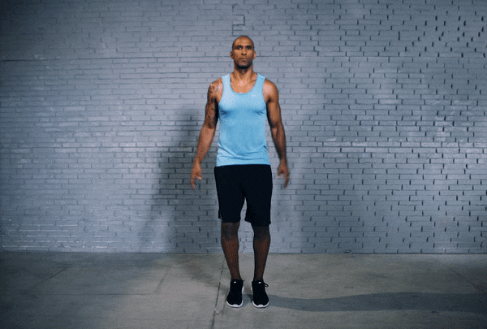
The villain is running at you. What do you do?
Wind Power
Super Strength
Notes:
A1

Slide 9
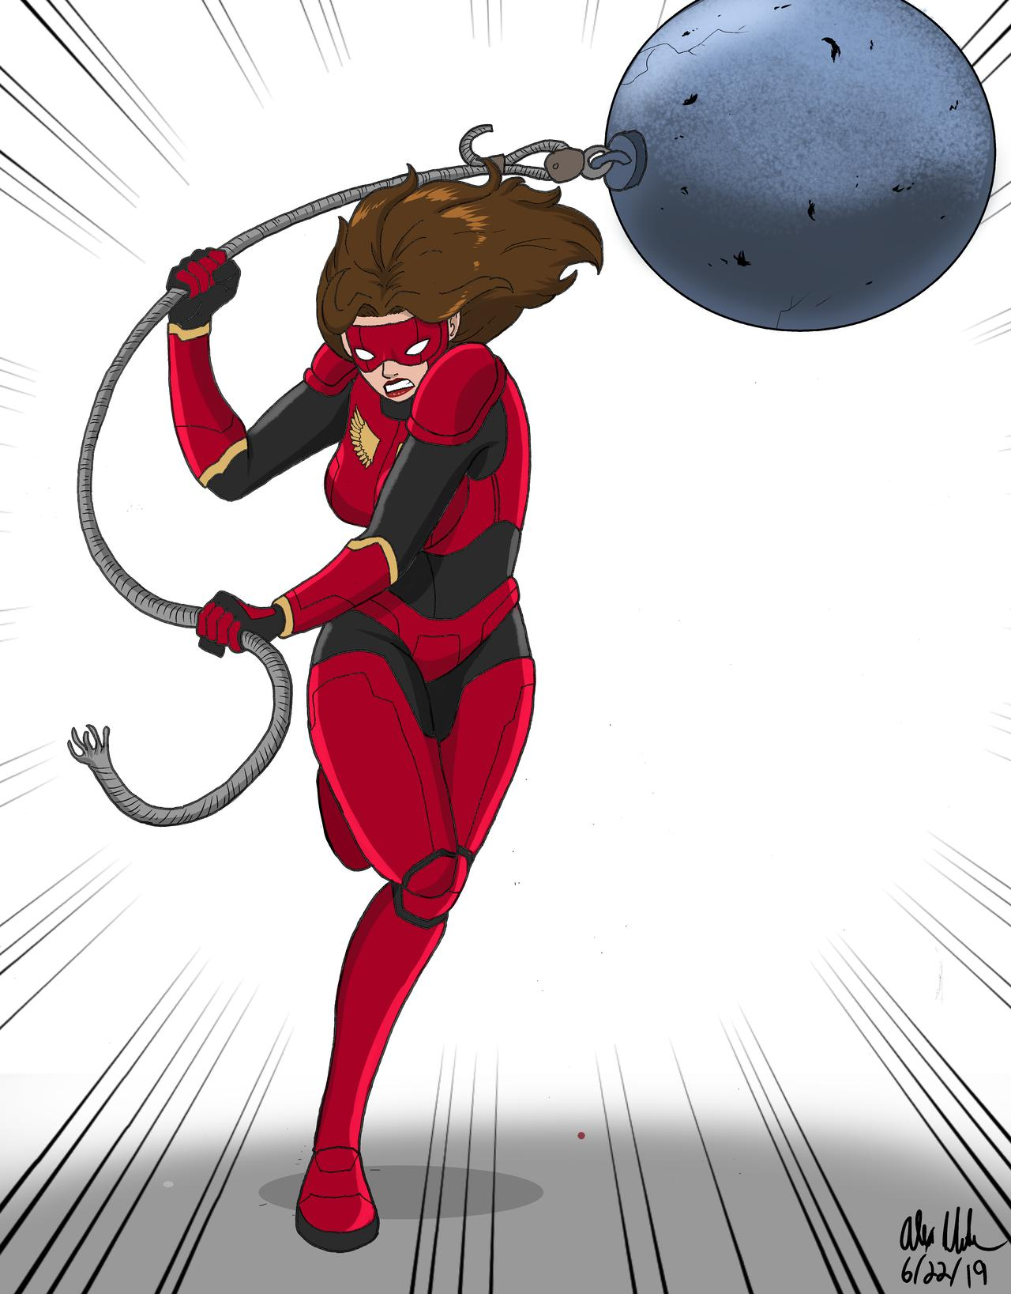
You twirl at super speeds and create a small tornado that sends the villain crashing into a wall that crumbles on top of him. Success! You don’t have much time to celebrate because you hear a roar coming from behind you.
a
As you turn, you see a villain swinging a huge metal ball at you! You have to act fast! Do you side step the attack, or fly at her head-on?
Continue
Notes:
A1

Slide 10
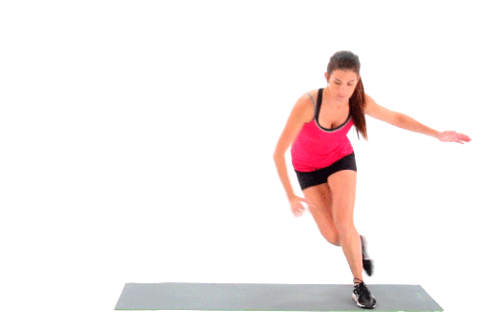
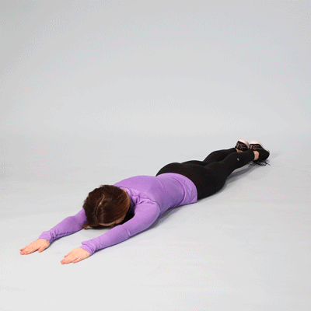
The Villain is swinging a ball and chain. What do you do?
Side step
Fly!
Notes:
A1

Slide 11
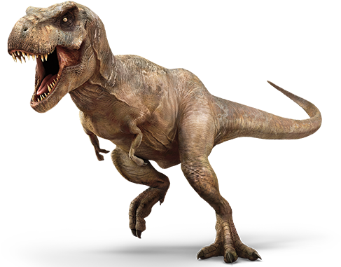
As you side step the attack, she misses and hits a fire hydrant and gets sprayed. water makes her very weak! You tie her up and quickly go to the sound of heavy footsteps and roaring. When you arrive, you see a T-rex trying to eat a family stuck in their car.
You think of 2 options for handling this situation. Do you club it with a nearby broken telephone pole, or call it away from the family to chase after you?
Continue
Notes:
A1

Slide 12
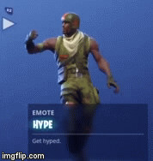
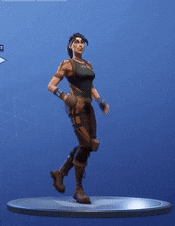
The family is in trouble! What do you do?
Club it!
Lead it away!
Notes:
A1

Slide 13
You pick up the broken pole and swing it like a bat, knocking the t-rex down onto a very sharp fence. You saved the family!
You have a chance to catch your breath! Time to decide what you want to do to settle your nerves. It’s been hectic!
Continue
Notes:
A1

Slide 14
How do you de-stress?
Tree pose
Gate
pose
Notes:
A1

Slide 15
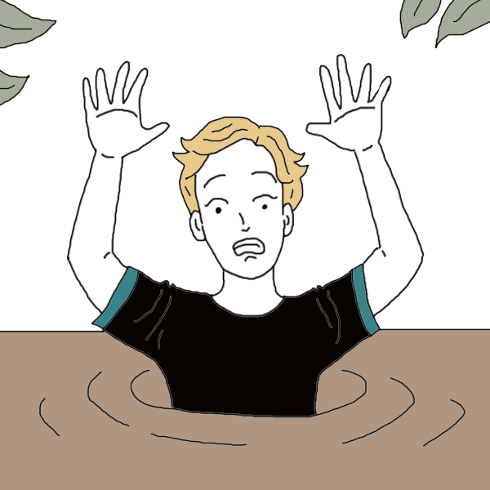
Alright, you feel a little less stressed! Suddenly, A nearby superhero calls out for you to help!
Looks like they got stuck in quicksand! hurry, do you try to pull them out with your hand, or spray water in to loosen it up?
Continue
Notes:
A1

Slide 16
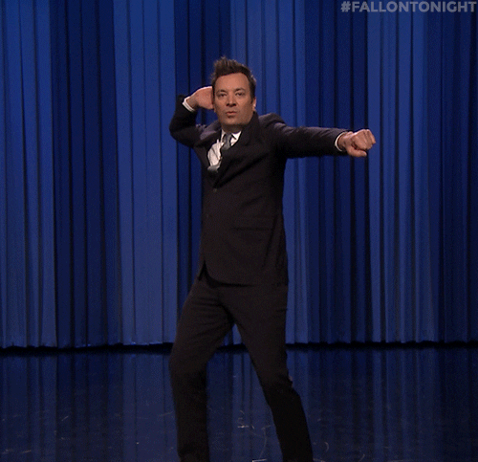
They’re sinking fast! What do you do?
Spray
water
Grab
hands
Notes:
A1

Slide 17
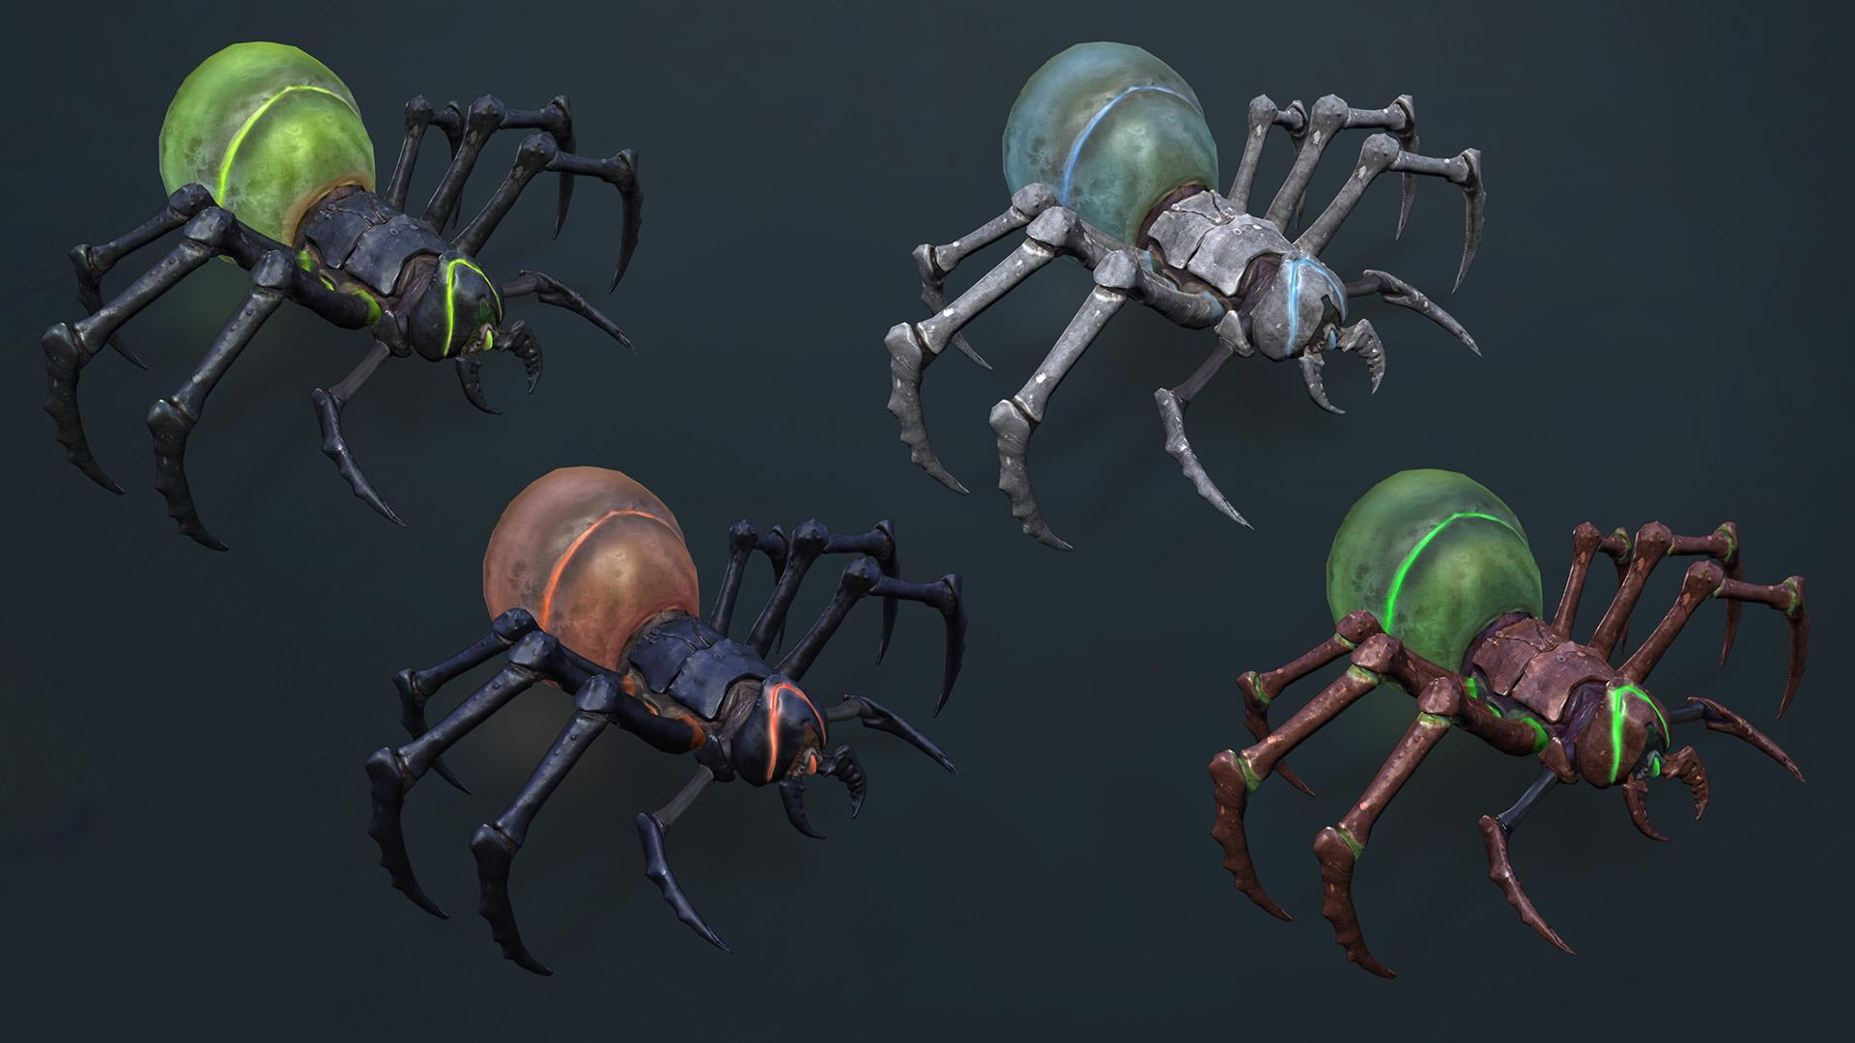
The water worked! It allowed them to move enough to grab a wire and pull themself out. They thank you, and then run off to help others. You decide to run the opposite direction towards the sound of a many insects.
As you get there, a bunch of alien spiders are trying to eat a bunch of people. You don’t
have much time...do you stomp the spiders
to death, or try a sonic hand clap?
Continue
Notes:
A1

Slide 18
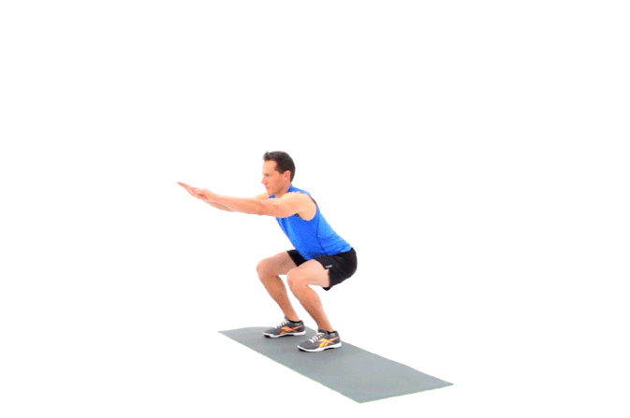
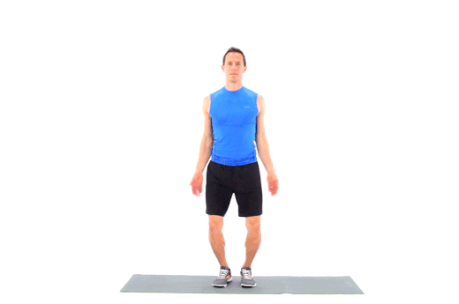
The spiders are about to eat people. choose!
Superstomp
Sonic
clap
Notes:
A1

Slide 19
You slap your hands together with mighty power, creating a sonic boom that seems to knock all the spiders out. You did it!
You hear screams close by. You see people on
a bridge that is starting to collapse! Do you bridge the gap with a rickety ladder or a telephone pole?
Continue
Notes:
A1

Slide 20
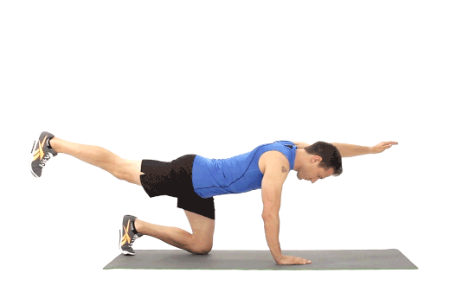
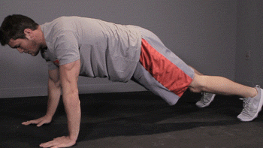
Do you use a ladder or
a pole to save them?
ladder
pole
Notes:
A1

Slide 21
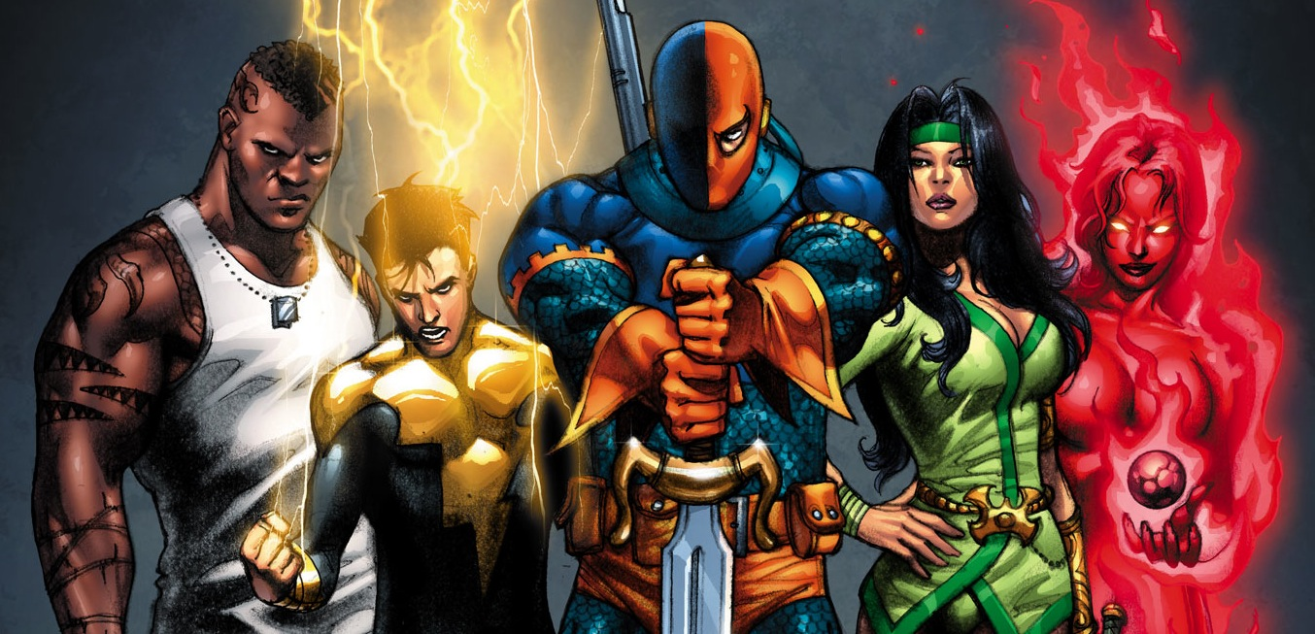
You decide on the ladder, and even though it’s old, everyone gets across safely. You saved many lives!
Before you can celebrate, a group of villains call out, “Hey hero, time to take you out for good.” with that they come at you furiously! This will be your toughest battle. Do you focus on quick or powerful moves?
Continue
Notes:
A1

Slide 22
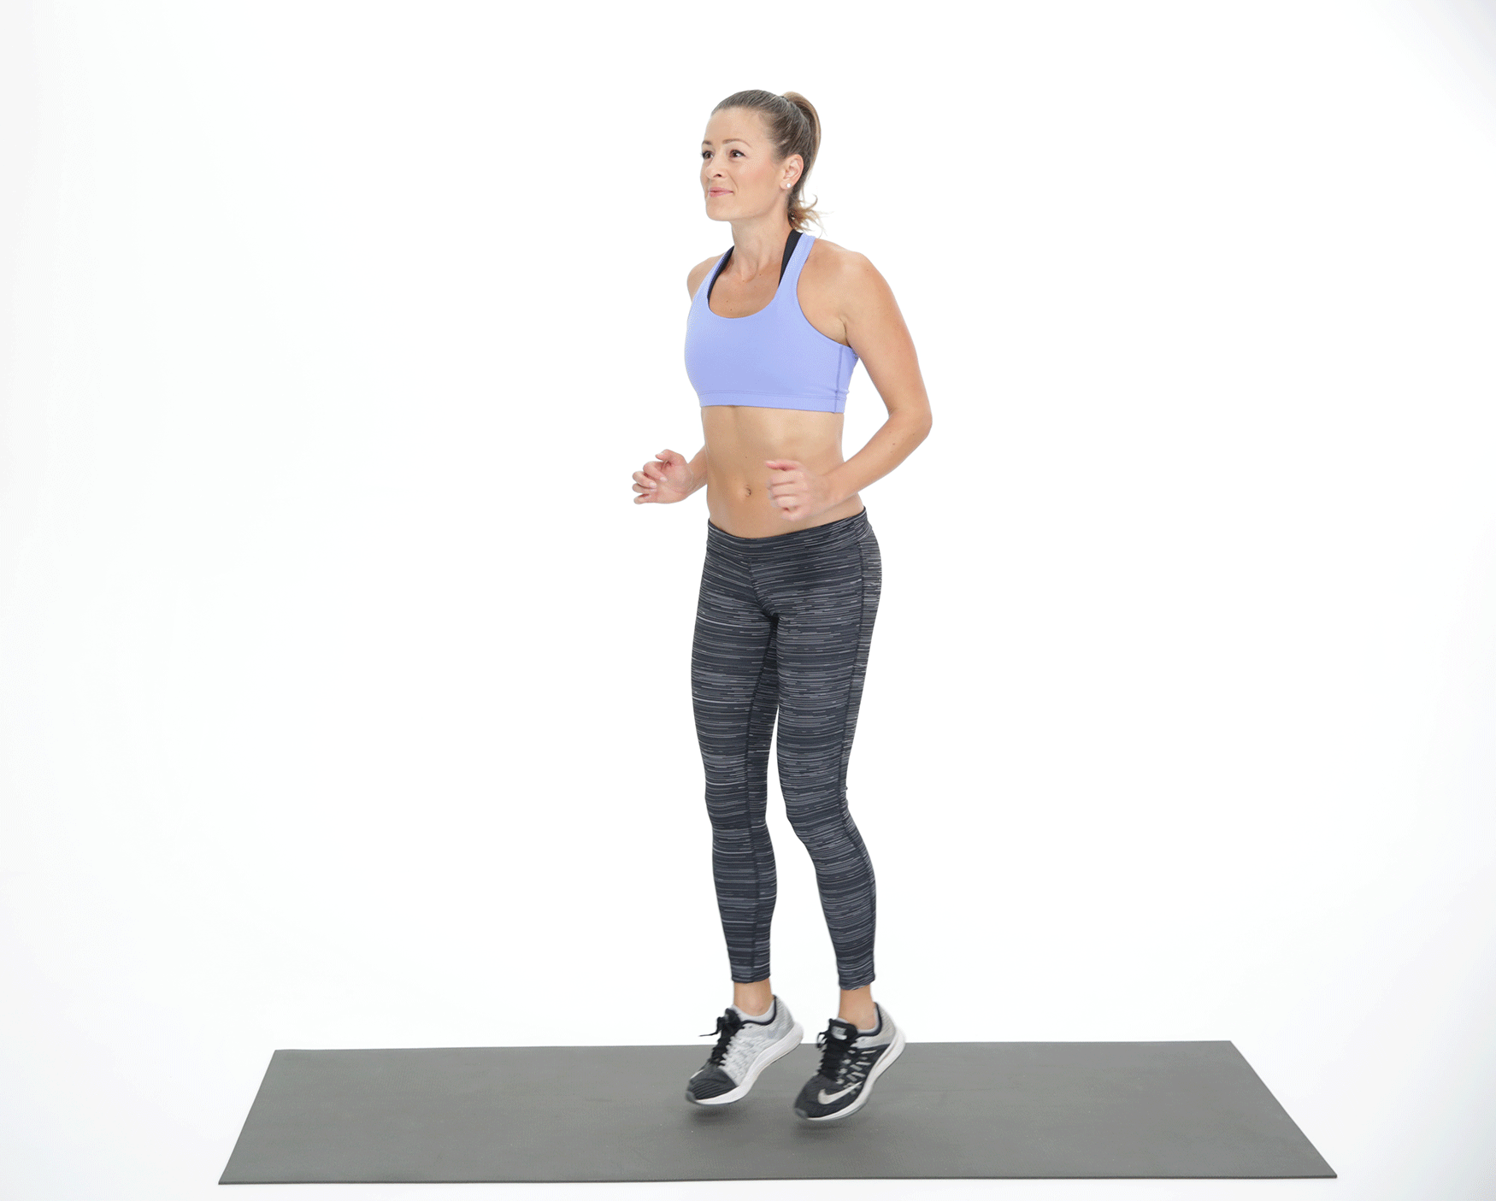
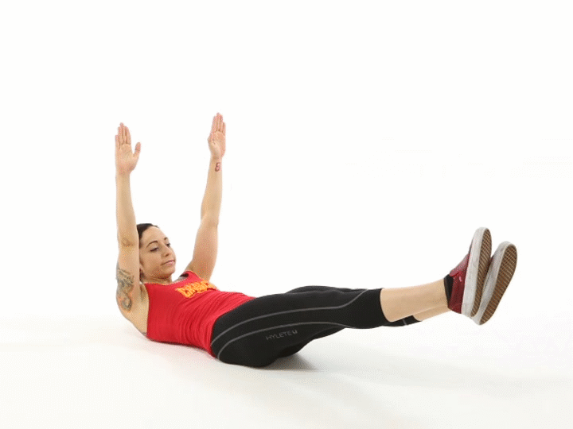
Do you decide on
speed or power?
speed!
Power!
Notes:
A1

Slide 23
Congratulations! You have become a mighty hero!
Try another adventure (soon)!

Slide 24
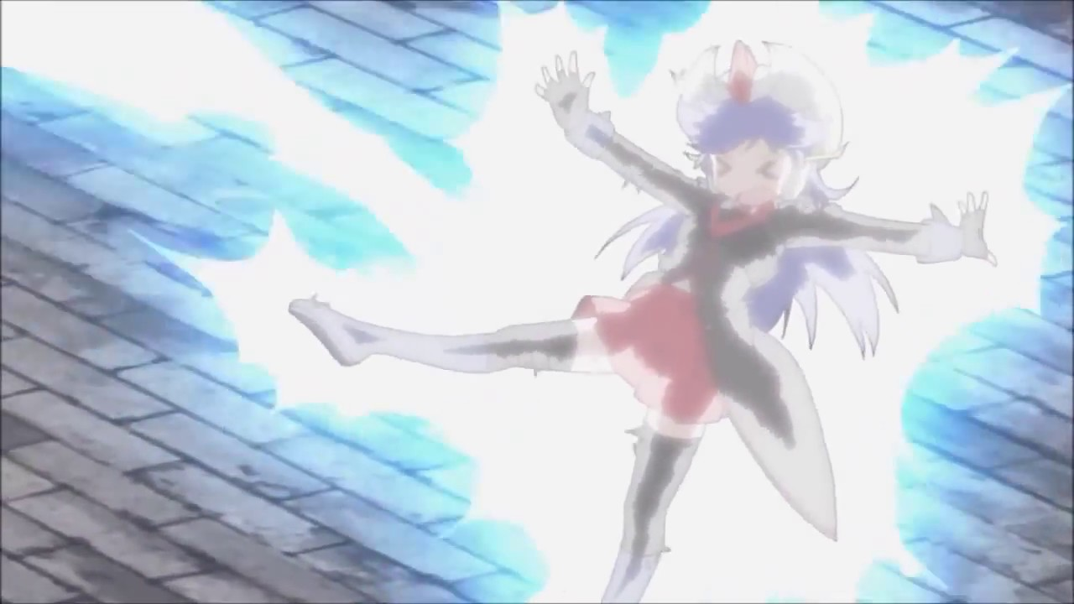
You get electrocuted when punching the robot and pass out. You’ve been defeated. Dust yourself off and
try again!
Try again!

Slide 25
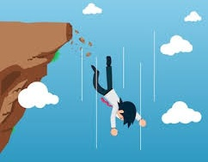
When you try to jump on the car, it swerves and you end up tumbling over a cliff! You have been defeated. Try again!
Try again!

Slide 26
When you try to match strength with the villain, he picks you up and throws you through a wall. You have been defeated. Try again!
Try again!

Slide 27
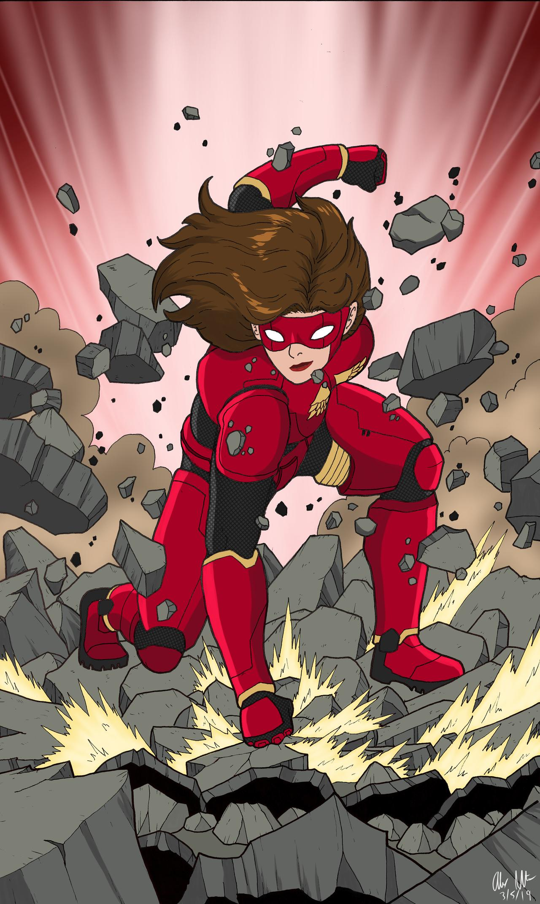
You fly at the villain, but she’s too fast and smashes you into the ground with the ball. You have been defeated. Try again!
Try again!

Slide 28
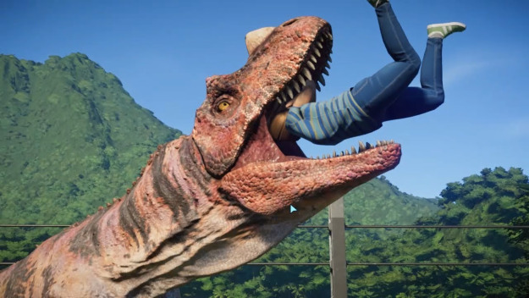
When you run away, you trip on something and the t-rex eats you.
You have been defeated. Try again!
Try again!

Slide 29
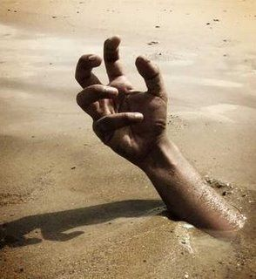
When you try to pull them out, the ground under you breaks, and you fall in with them. You have been defeated. Try again!
Try again!

Slide 30
You can’t stop them all fast enough! They devour everyone, including you. You have been defeated. Try again!
Try again!

Slide 31
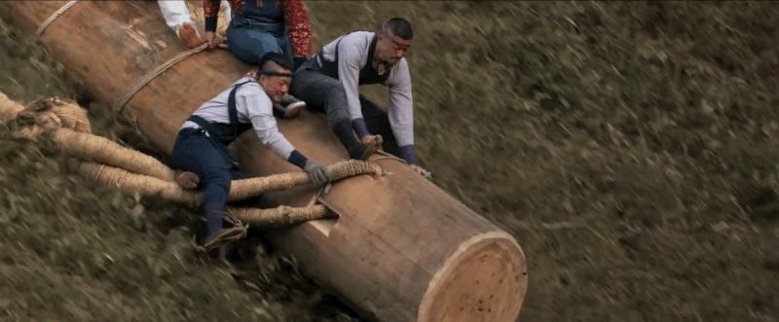
You get people to start crossing the pole...but it’s round and rolls sideways, tumbling off the bridge. You have been defeated. Try again!
Try again!

Slide 32
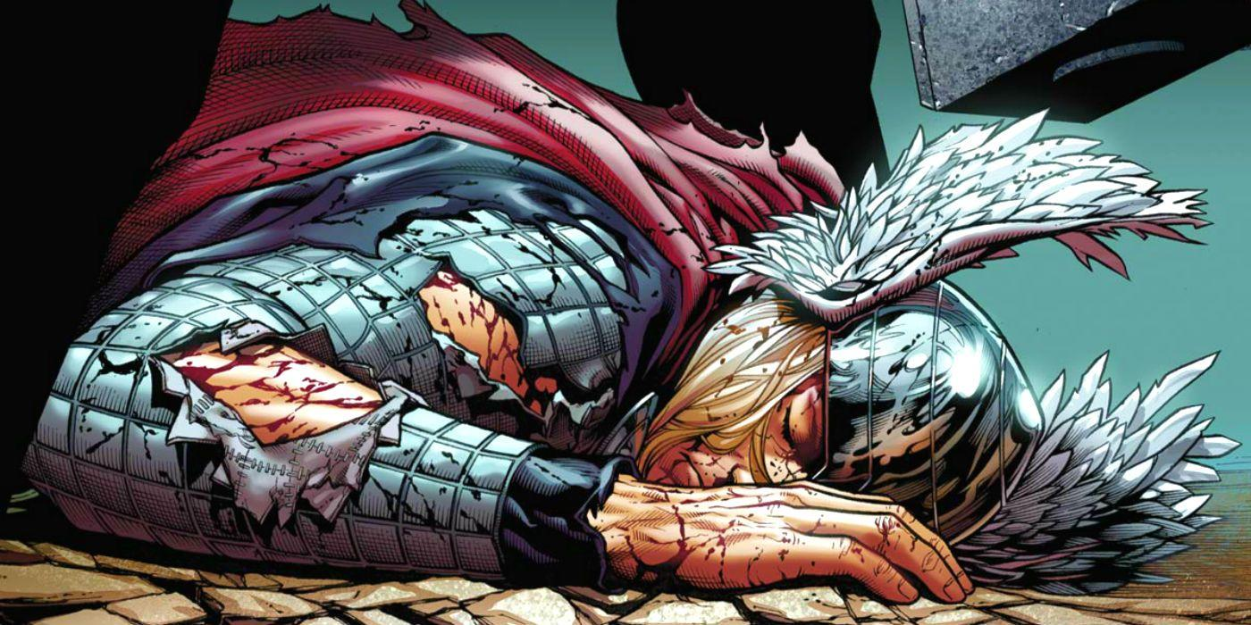
You try brute force, but there are too many of them. You have been defeated. Try again!
Try again!

Slide 33
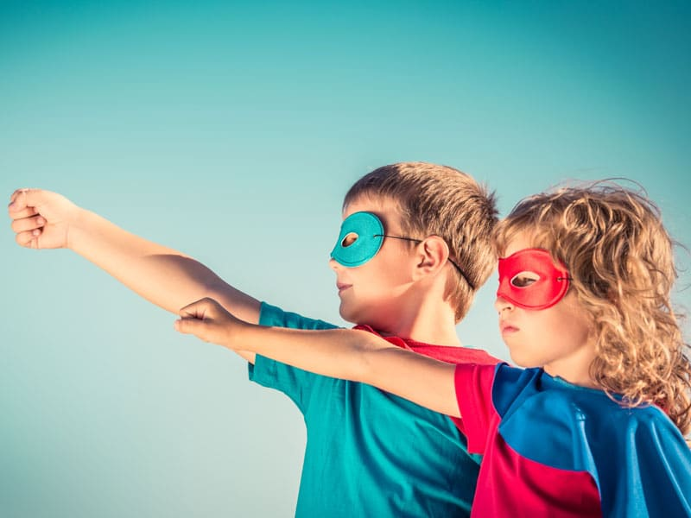
This adventure was created by:
Mike ginicola @physeddepot
My website
Follow me
On twitter
TPT store
Youtube
channel

