Slide 1
This or That Workout

Slide 2
CHOOSE!
5
APPLES
BANANAS

Slide 3
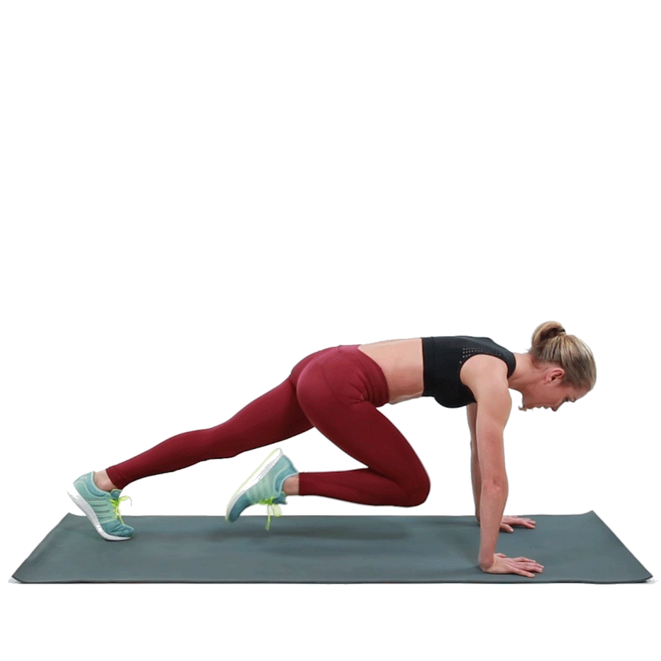
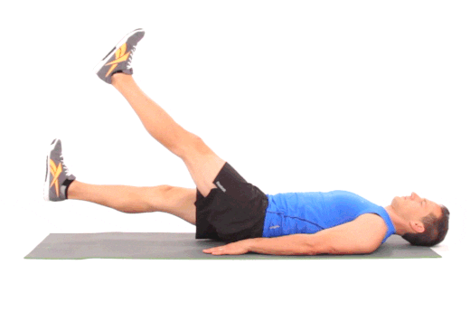
EXERCISE!!
30
Flutter Kicks
Mountain Climbers

Slide 4
REST!
15

Slide 5
CHOOSE!
5
pizza
tacos

Slide 6
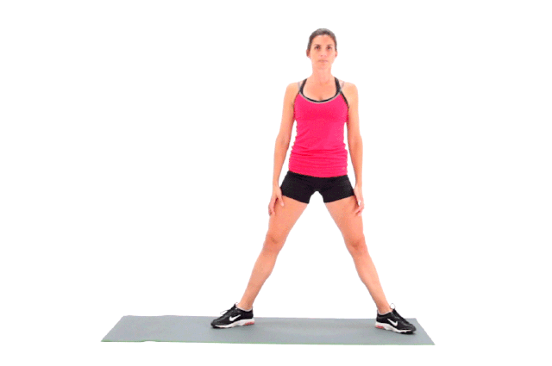
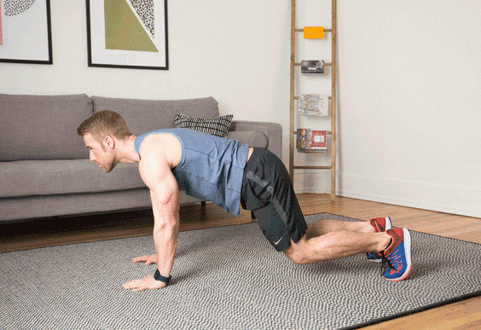
EXERCISE!!
30
Air Squats
Donkey Kicks

Slide 7
REST!
15

Slide 8
CHOOSE!
5
Beach
pool

Slide 9
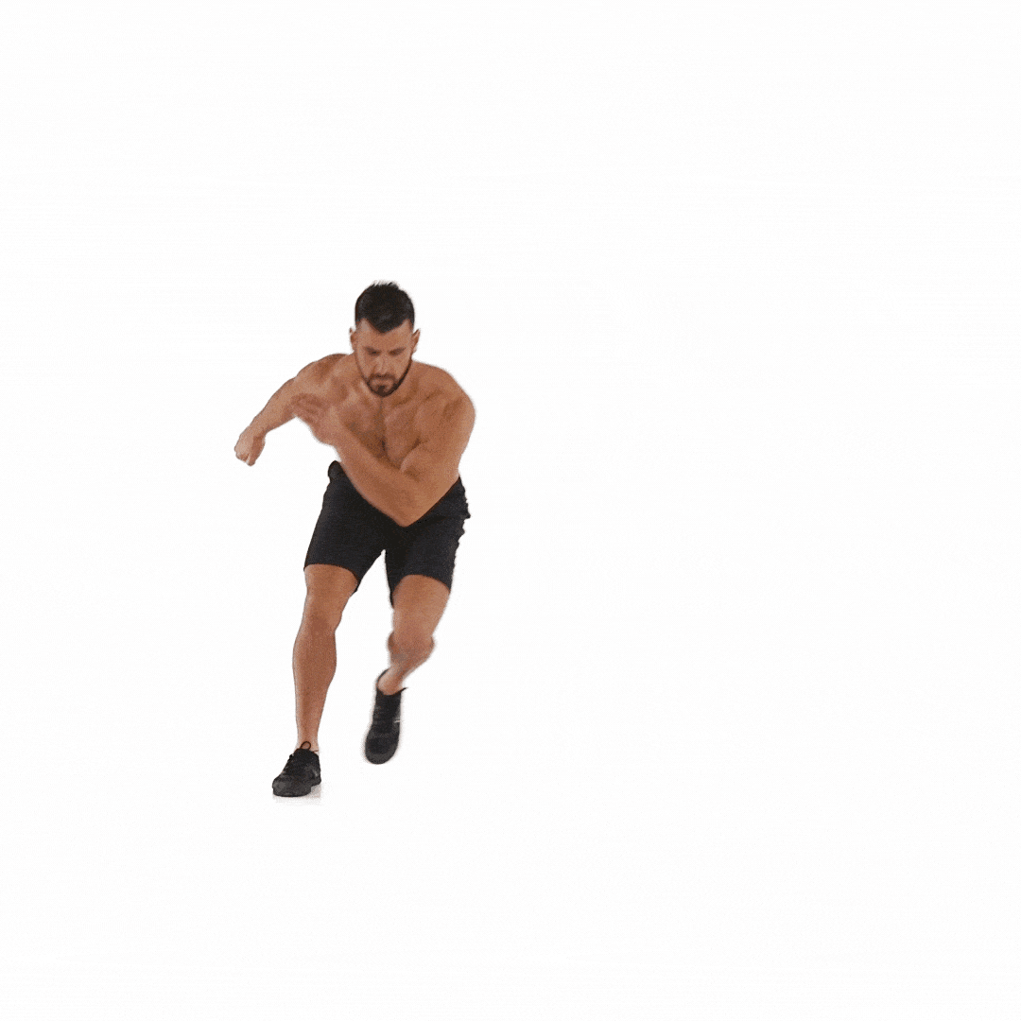
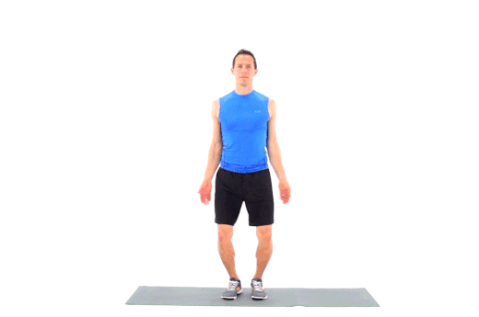
EXERCISE!!
30
Jumping Jacks
Skaters

Slide 10
REST!
15

Slide 11
CHOOSE!
5
puppies
kittens

Slide 12
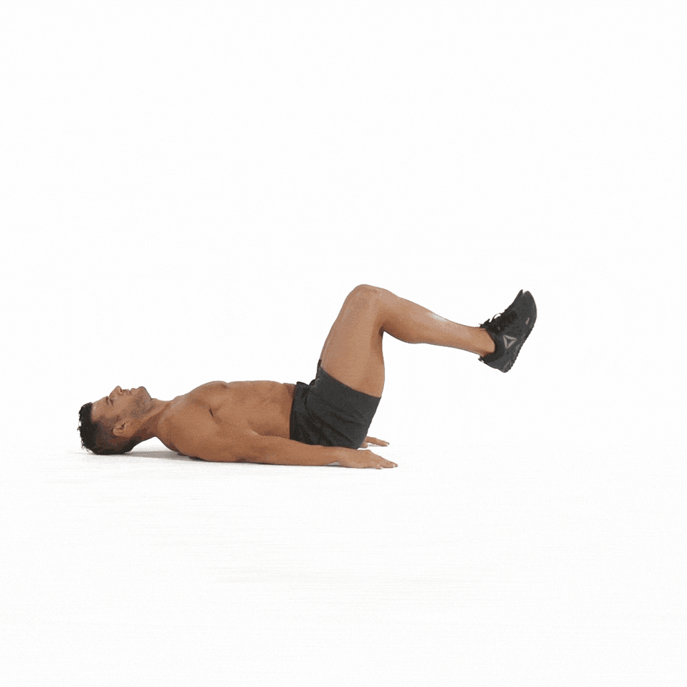
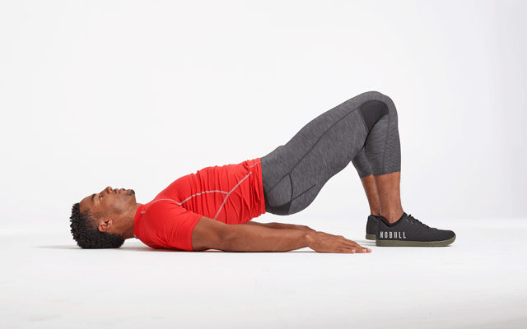
EXERCISE!!
30
Glute Bridge
Bent Leg Raises

Slide 13
REST!
15

Slide 14
CHOOSE!
5
Ice cream
popsicles

Slide 15
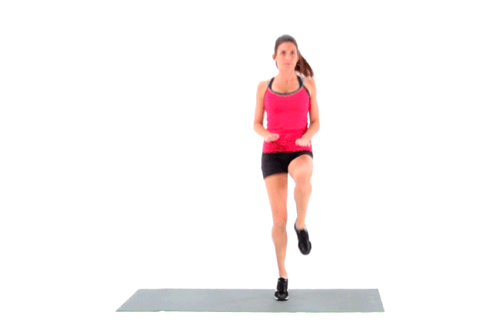
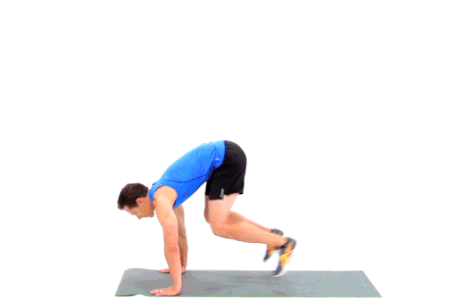
EXERCISE!!
30
High Knees
Plank To Standing

Slide 16
REST!
15

Slide 17
CHOOSE!
5
football
basketball

Slide 18
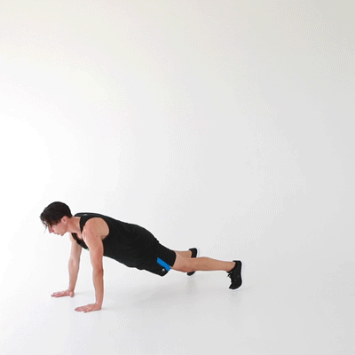
EXERCISE!!
30
Knee to Elbow
Walkouts

Slide 19
REST!
15

Slide 20
CHOOSE!
5
Dancing
Singing

Slide 21
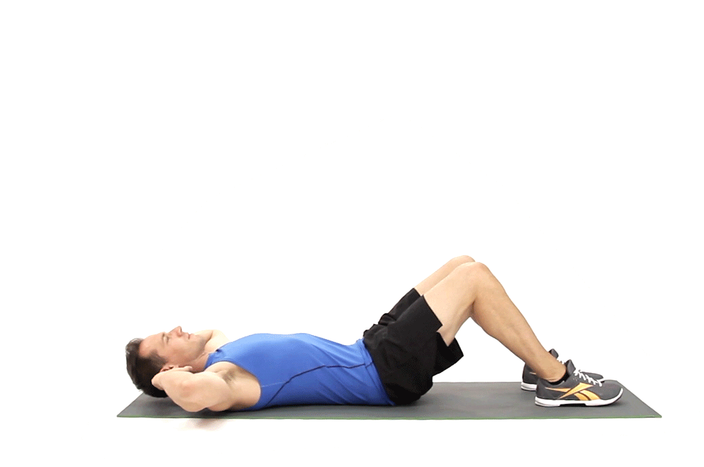
EXERCISE!!
30
Alternating Leg Raises
Crunches

Slide 22
REST!
15

Slide 23
CHOOSE!
5

Slide 24
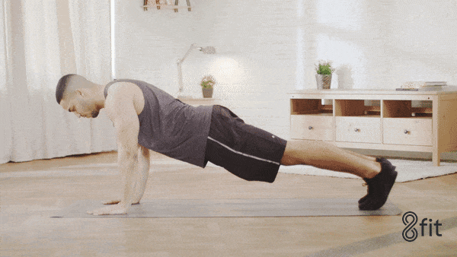
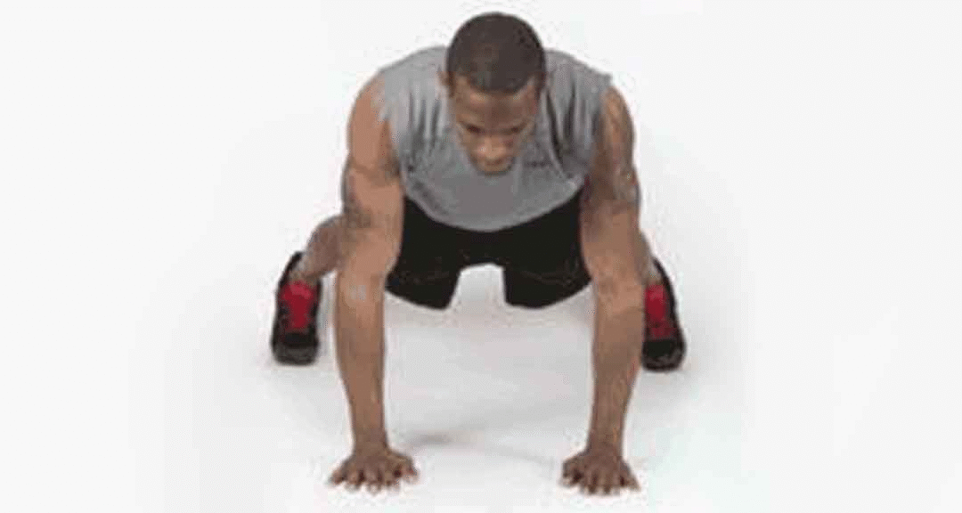
EXERCISE!!
30
High to Low Plank
Shoulder Taps

Slide 25
REST!
15

Slide 26
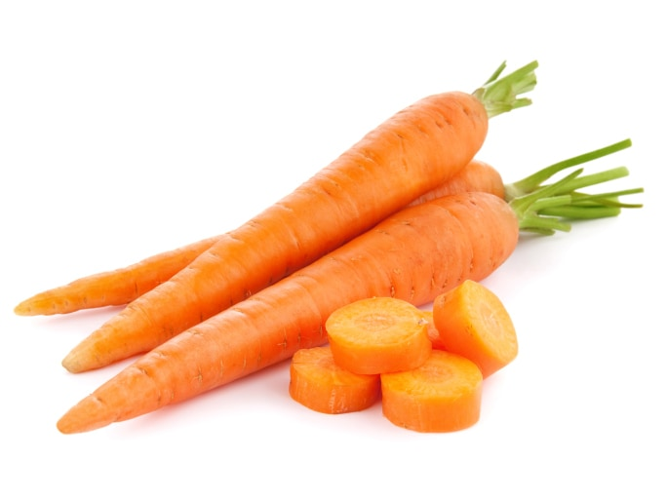
CHOOSE!
5
Broccoli
Carrots

Slide 27
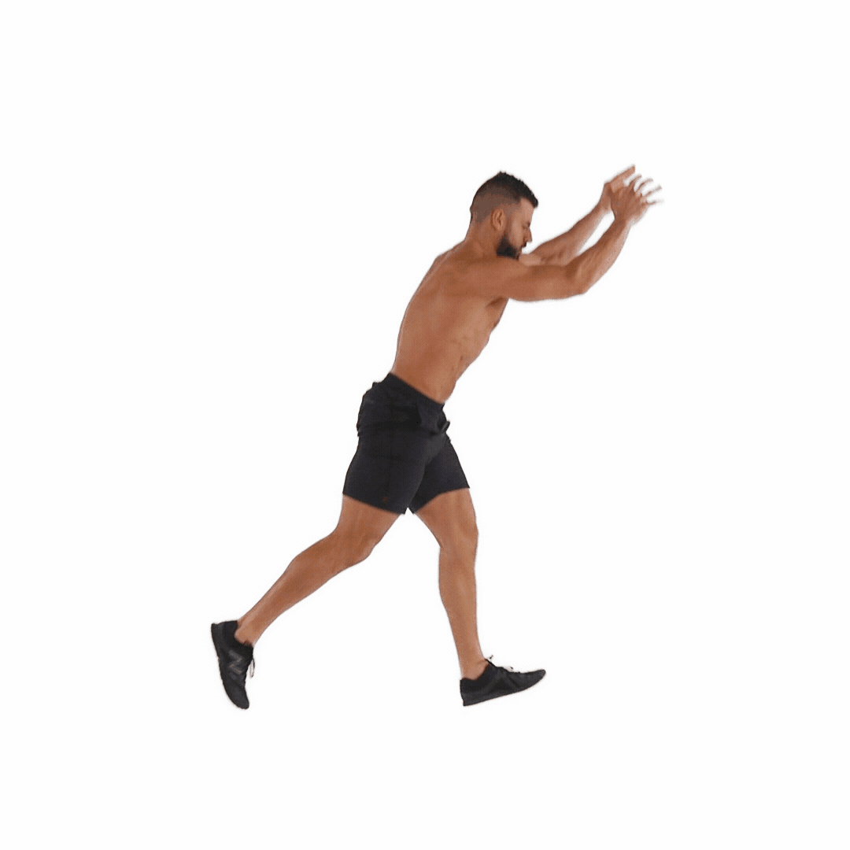
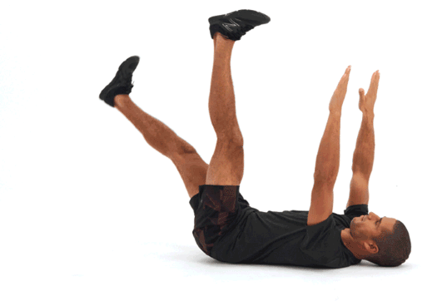
EXERCISE!!
30
Dead Bug
Jumping Lunges

Slide 28
REST!
15

Slide 29
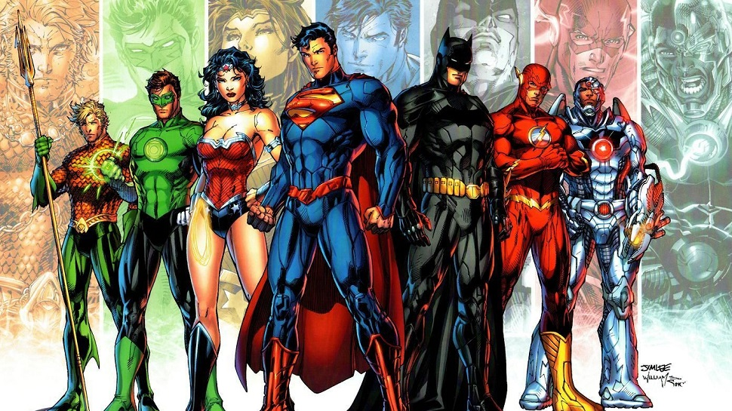
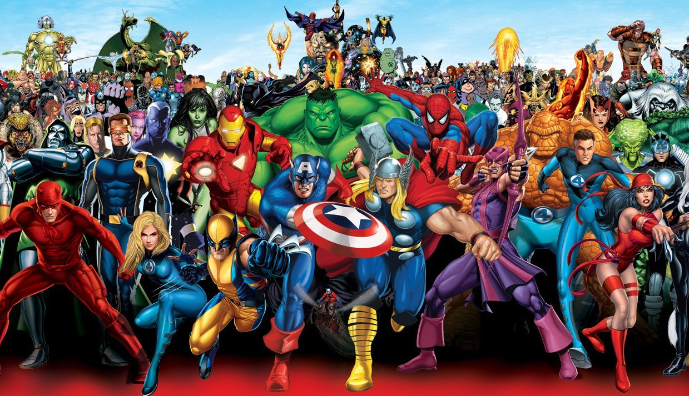
CHOOSE!
5
DC Comics
marvel

Slide 30
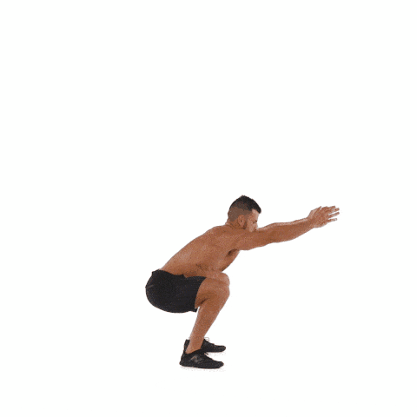
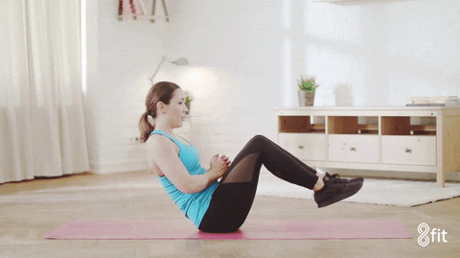
EXERCISE!!
30
Squat Jumps
Russian Twist

Slide 31
REST! You did it!
15

