Slide 1
This or That Workout 2

Slide 2
CHOOSE!
5
BEACH BEAR
BEACH PUP

Slide 3
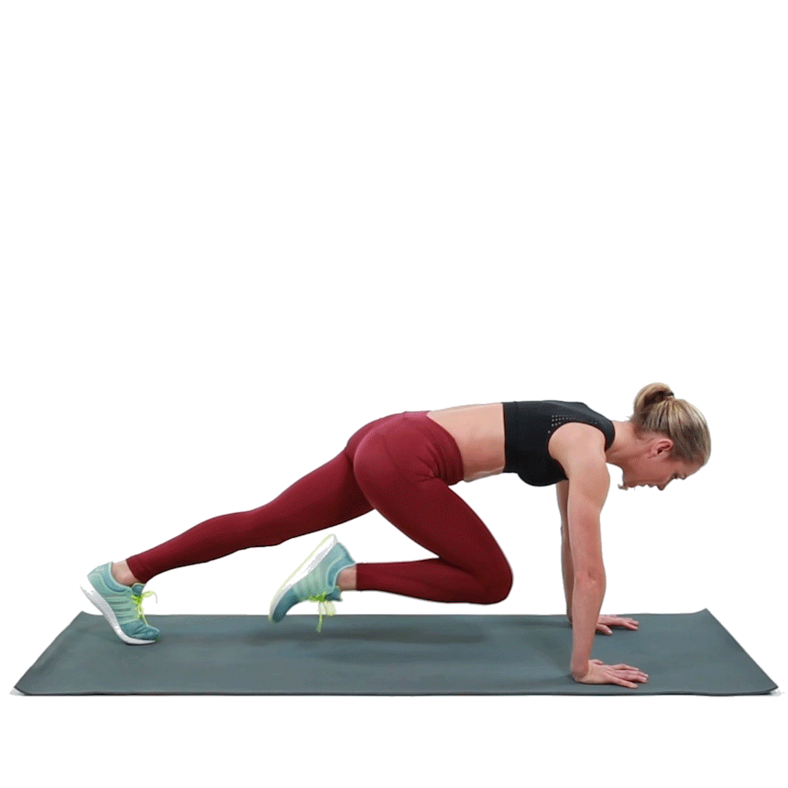
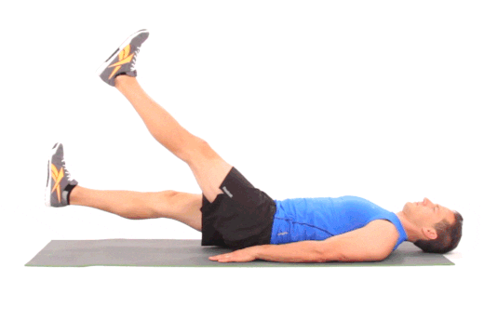
EXERCISE!!
30
Flutter Kicks
Mountain Climbers

Slide 4
REST!
15

Slide 5
CHOOSE!
5
BASE RUN BOY
BASE RUN GIRL

Slide 6
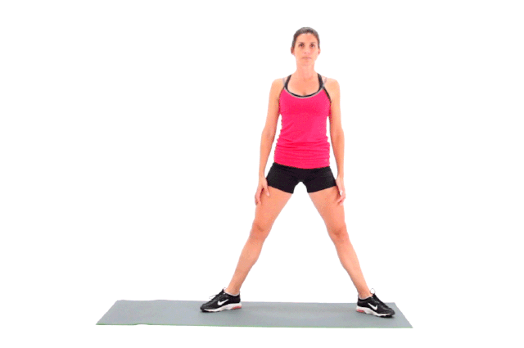
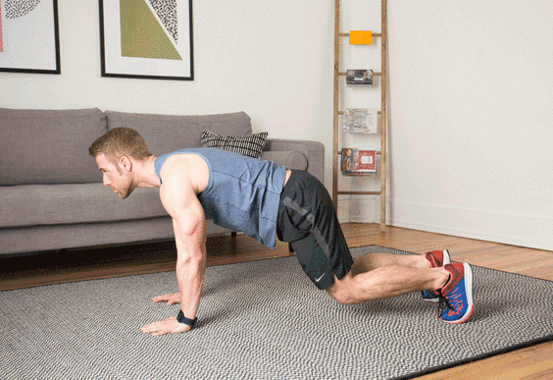
EXERCISE!!
30
Air Squats
Donkey Kicks

Slide 7
REST!
15

Slide 8
CHOOSE!
5
CHEMIST
REPORTER

Slide 9
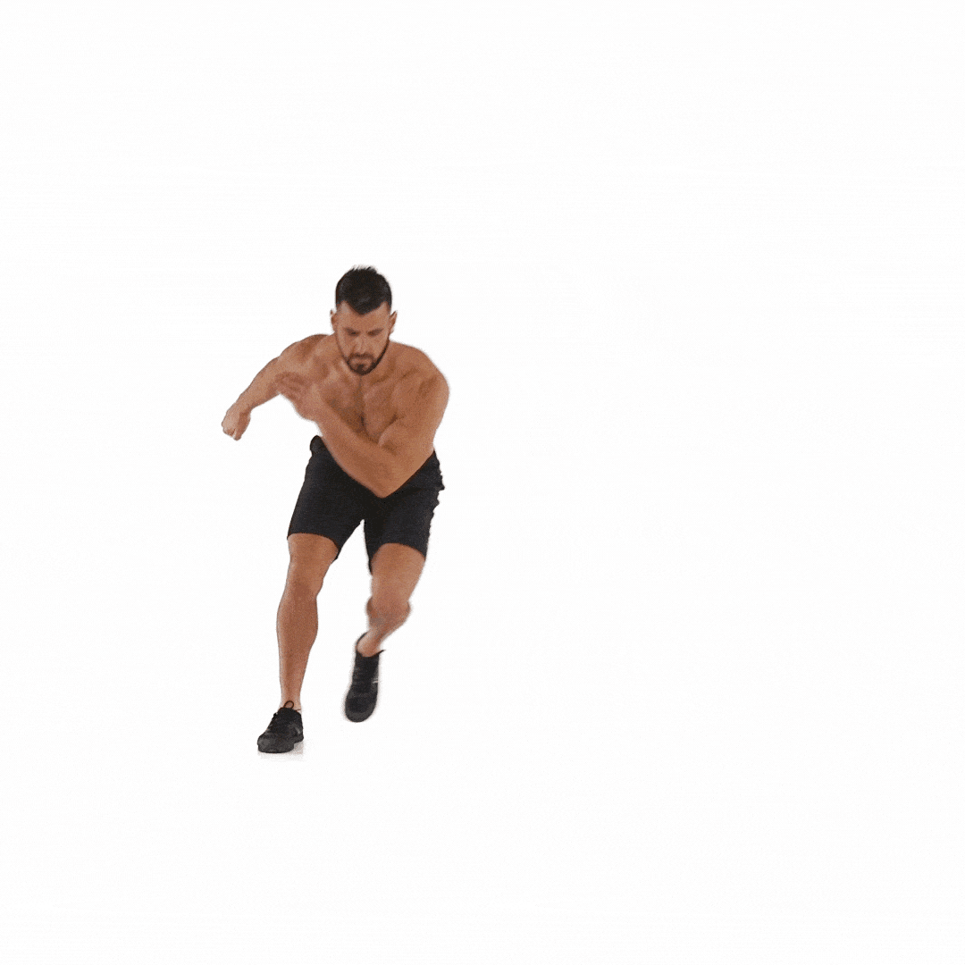
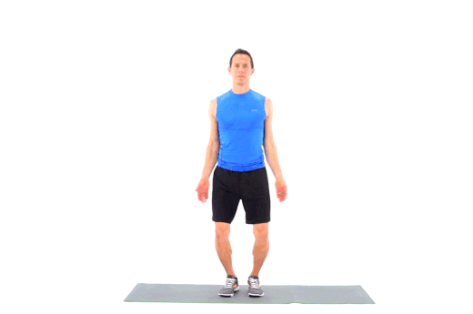
EXERCISE!!
30
Jumping Jacks
Skaters

Slide 10
REST!
15

Slide 11
CHOOSE!
5
FOOTBALL RUN
FOOTBALL CATCH

Slide 12
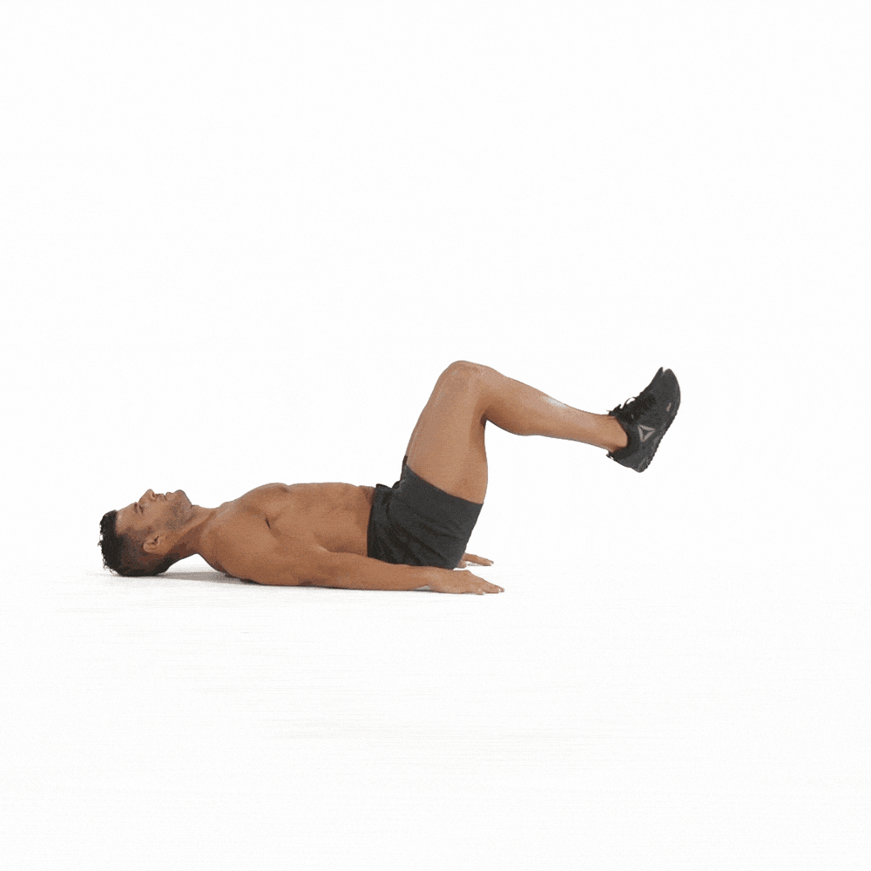
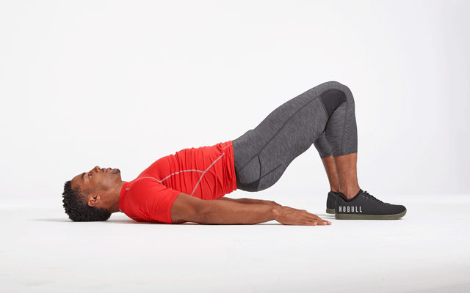
EXERCISE!!
30
Glute Bridge
Bent Leg Raises

Slide 13
REST!
15

Slide 14
CHOOSE!
5
GRANDMA SHARK
GRANDPA SHARK

Slide 15
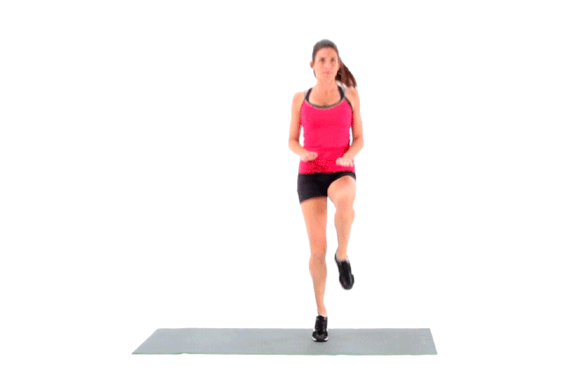
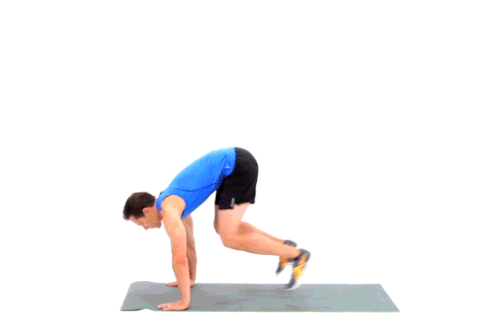
EXERCISE!!
30
High Knees
Plank To Standing

Slide 16
REST!
15

Slide 17
CHOOSE!
5
RINGS
BEAM

Slide 18
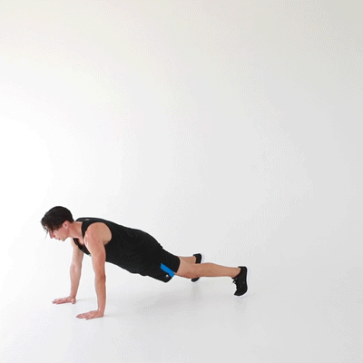
EXERCISE!!
30
Knee to Elbow
Walkouts

Slide 19
REST!
15

Slide 20
CHOOSE!
5
RED BIRD
BLUE BIRD

Slide 21
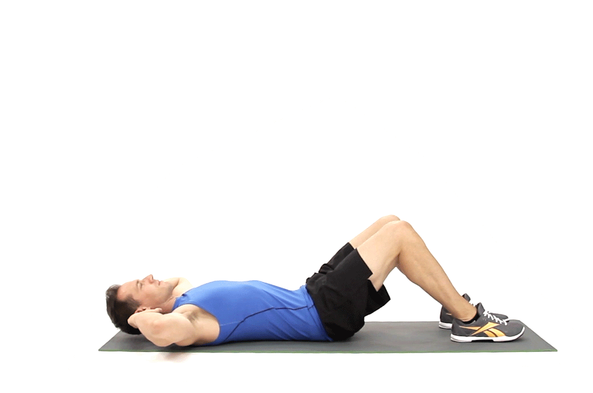
EXERCISE!!
30
Alternating Leg Raises
Crunches

Slide 22
REST!
15

Slide 23
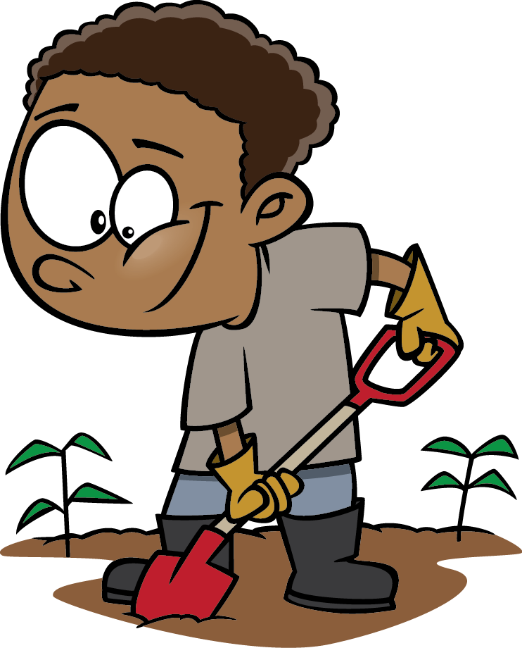
CHOOSE!
5
GARDNER
MATHEMATICIAN

Slide 24
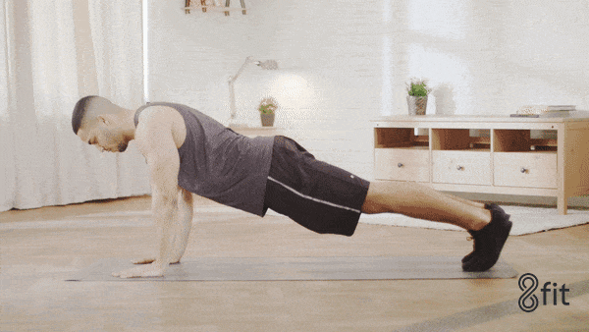
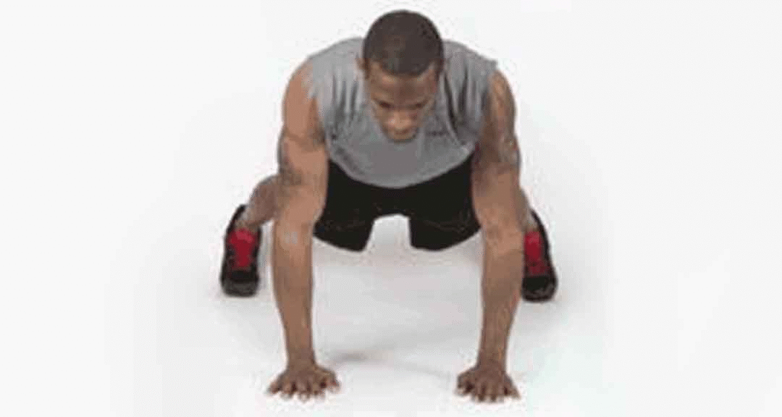
EXERCISE!!
30
High to Low Plank
Shoulder Taps

Slide 25
REST!
15

Slide 26
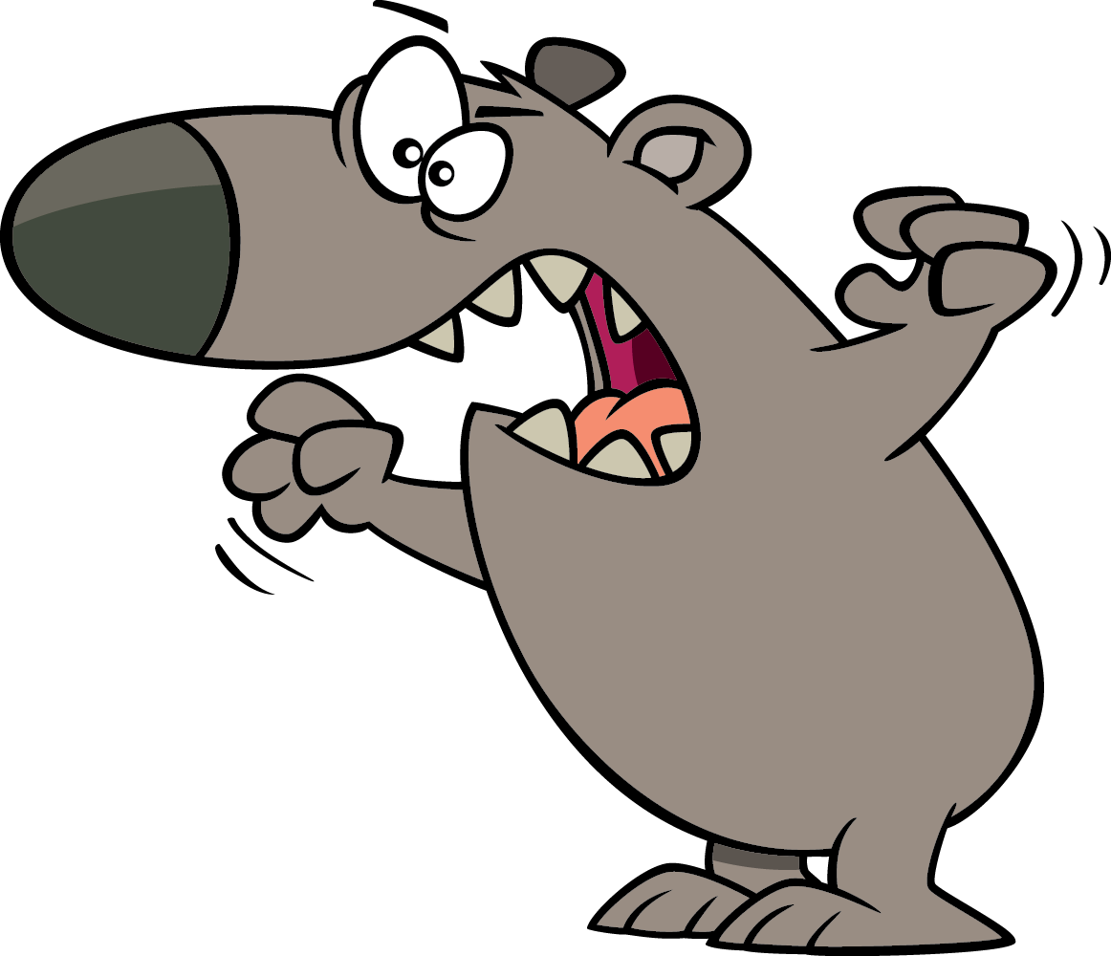
CHOOSE!
5
Llama
Bear

Slide 27
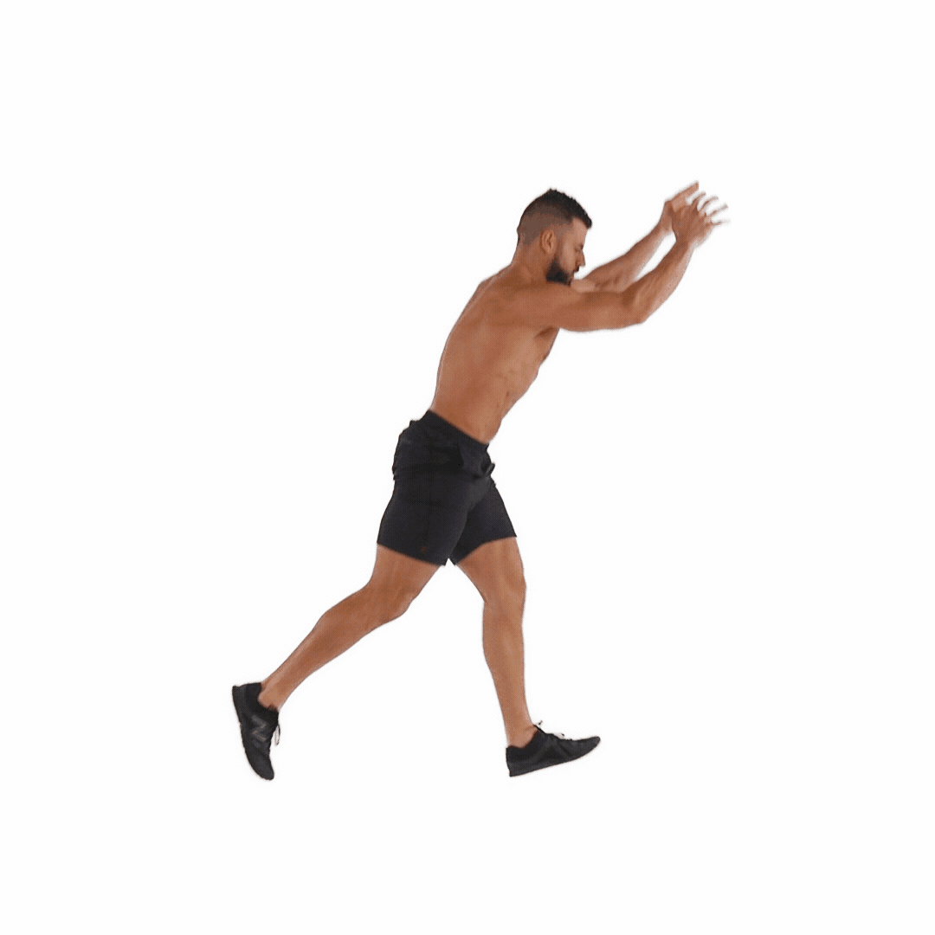
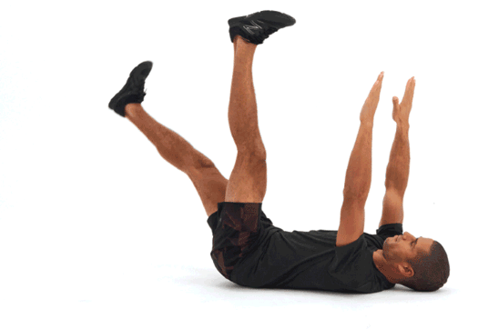
EXERCISE!!
30
Dead Bug
Jumping Lunges

Slide 28
REST!
15

Slide 29
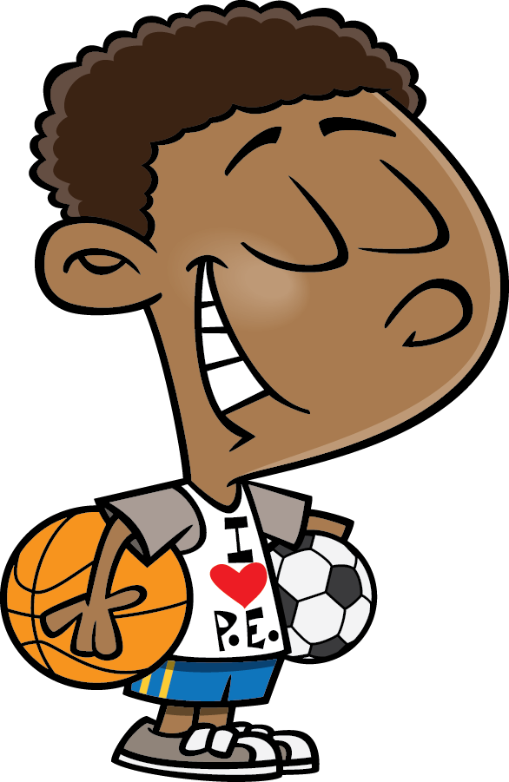
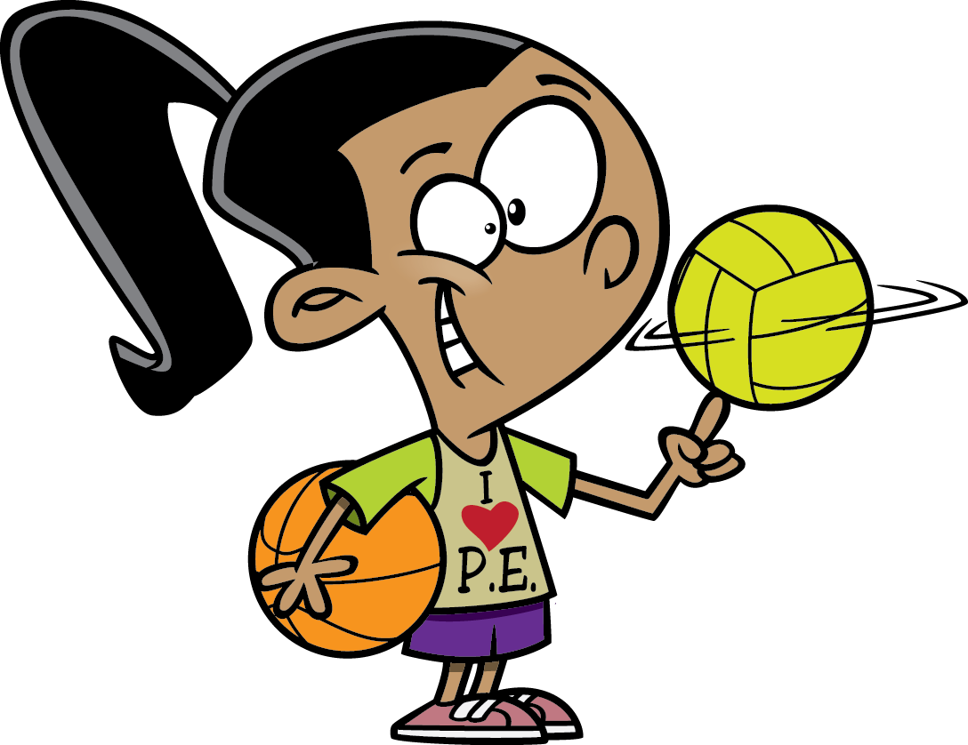
CHOOSE!
5
PHYSICAL EDUCATION BOY
PHYSICAL EDUCATION GIRL

Slide 30
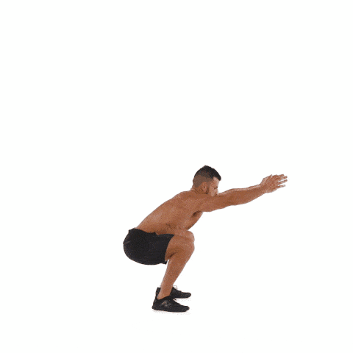
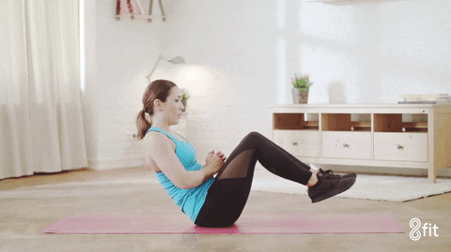
EXERCISE!!
30
Squat Jumps
Russian Twist

Slide 31
REST! You did it!
15

